Slide 1
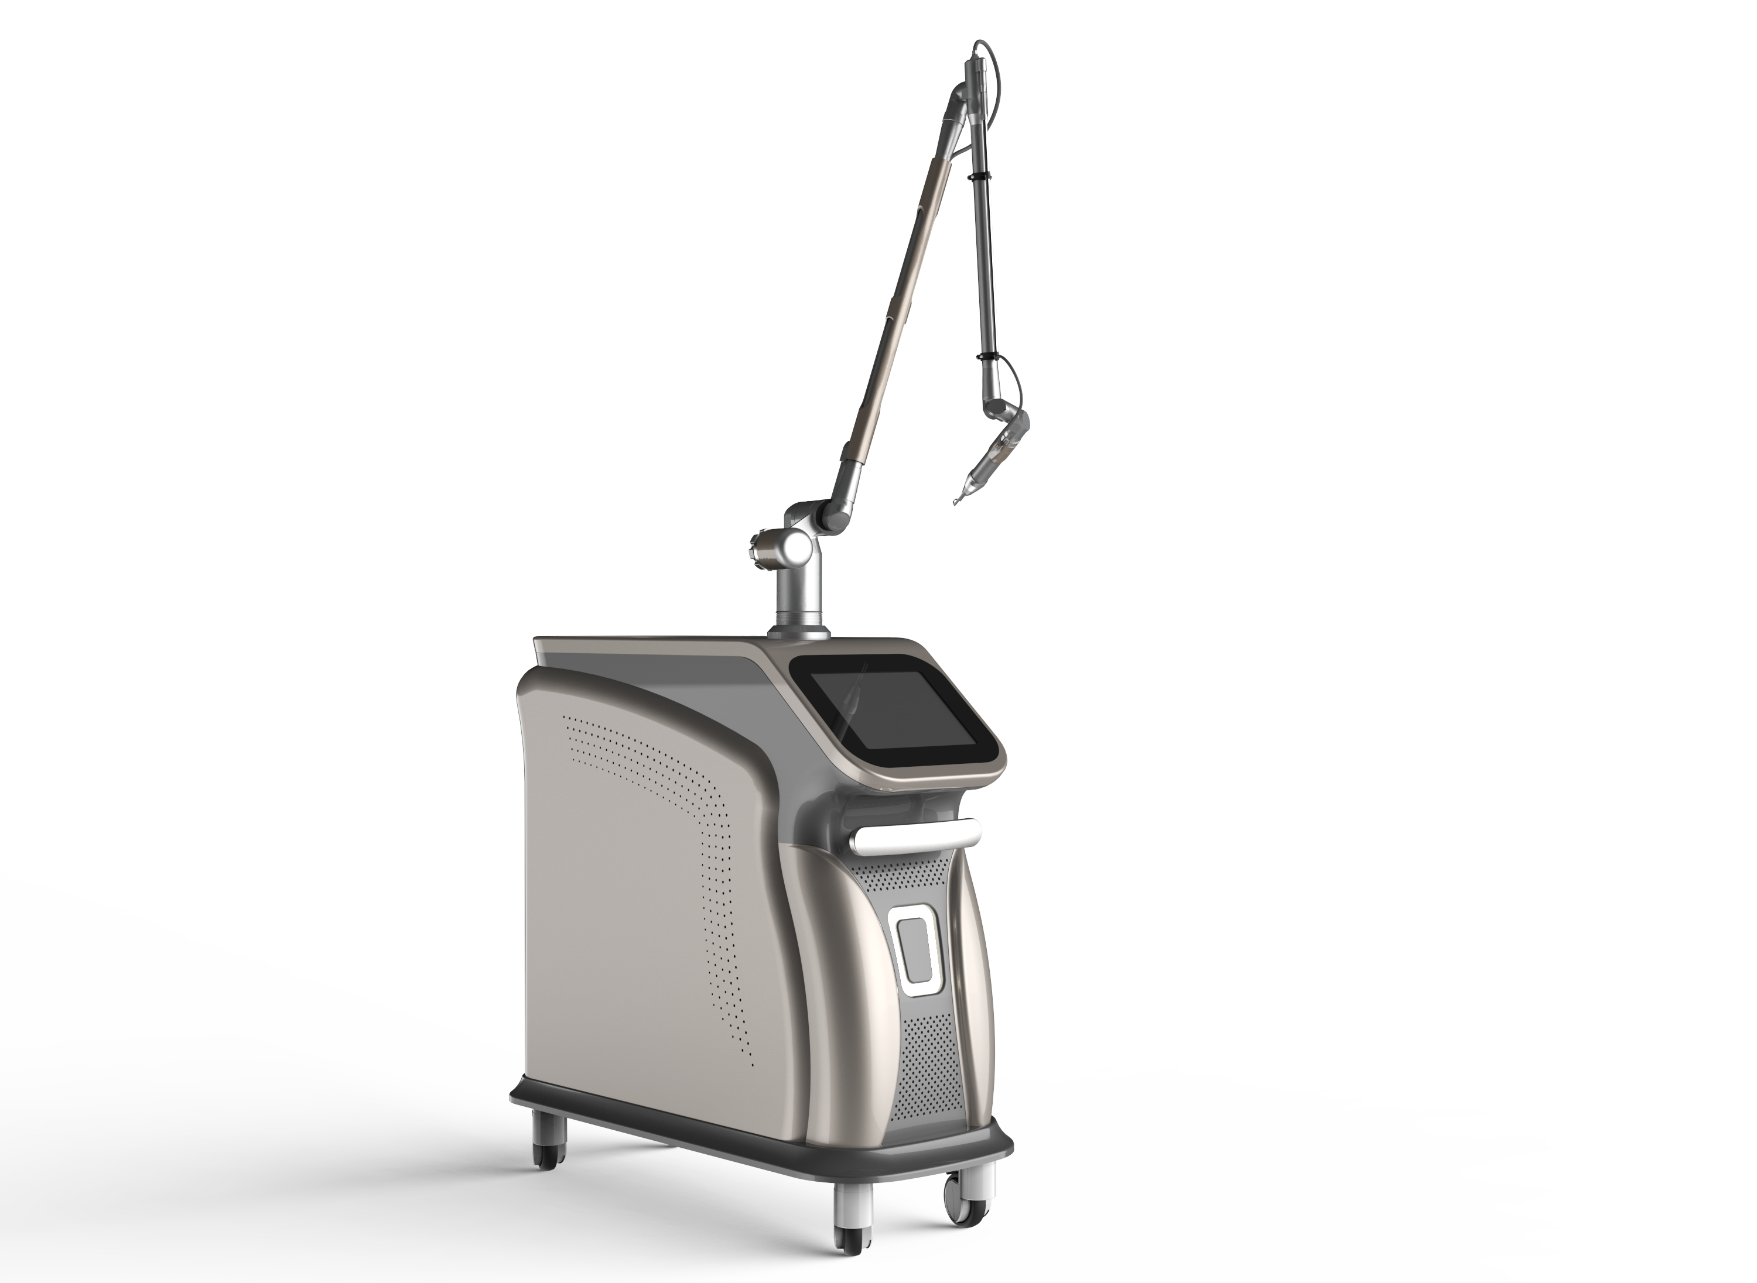

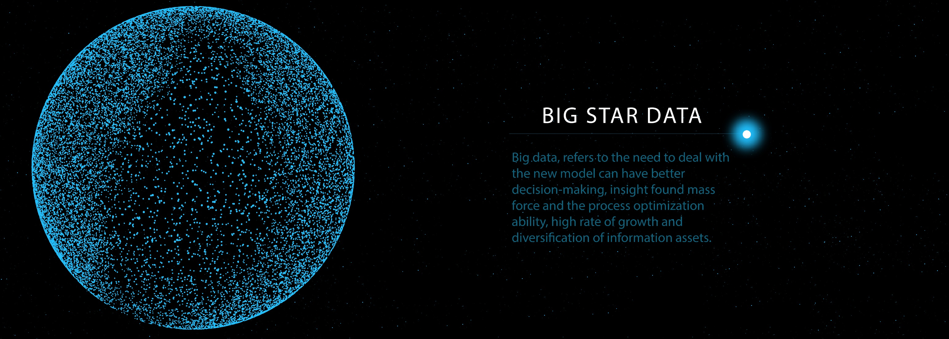
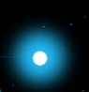

PICO
SECOND
ND:YAG Laser Skin CARE SYSTEM
Mode No.:SP-2

Slide 2

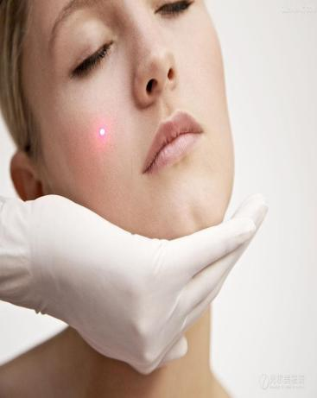



What is Pico second laser?
Pico second laser is the latest new generation technology for aesthetic use. Through trillions of a second and powerful laser energy to grind the pigment in the skin tissue to reach the result of completely tattoo removal and pigment in all type of skin color.
Through specialized fractional lens, Pico second laser can convert laser energy into gentle pressure to create new collagen by squeezing cells and activating the natural cell without burning or damaging the skin.

Slide 3


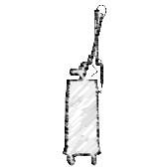
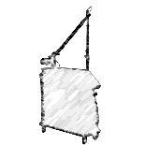
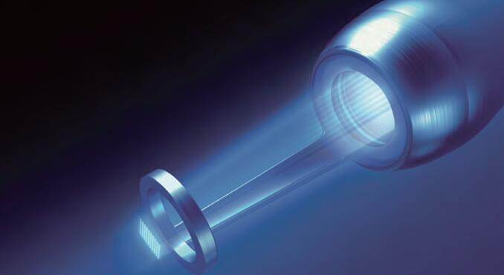
What is Pico second laser?
532nm can remove age spots, epidermal spots, red birthmarks and red tattoos
585nm can remove the yellow color tattoo
650nm can remove the green color tattoo and blue color tattoo.
1064nm can remove the derma layer pigment in the face and body, sucha birthmark, nevus of Ota, coffee spot, blue and black color tattoo.

Slide 4

Advantage of Pico second laser
High energy & Shot
pulse duration
Minimal risk and
less pain
No anesthesia during the treatment, No inflammation
The power emit in trillions of a second to skin tissue, which can explore the pigment into much more small pieces than tradational Q:switch laser. The pigment pieces can be absorbed more easily and faster
Since the pulse duration has been reduced thousand of time, less damage of skin is realized. The treatment is more safe and less pain
Fast
For tattoo removal, usually 6-8 treatment is necessary by Traditional Q:switch laser. With pico second laser, only 3-4 treatment is needed only for completely removal.
High performance
Completely removal of tattoo and pigment can be reached with Pico second technology
Suitable for skin color from I-IV skin Type,
no hype pigmentation after treatment

Slide 5
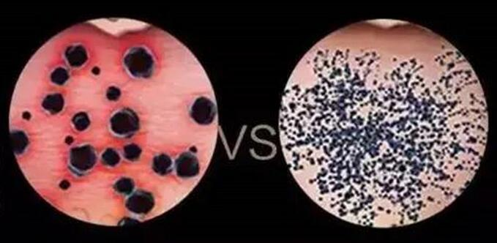
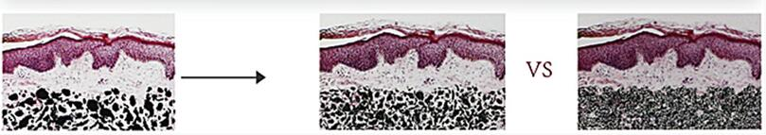
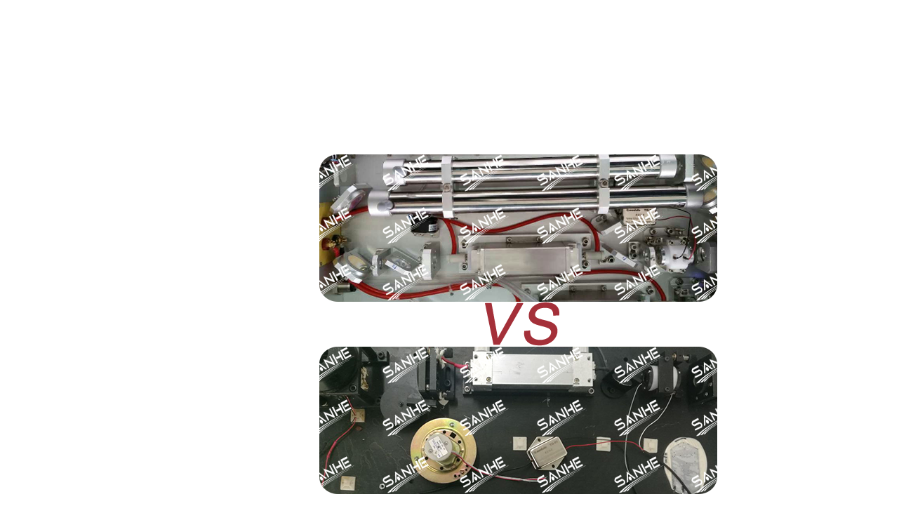
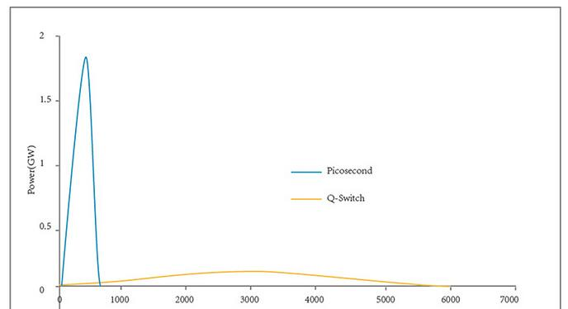
Picosecond VS Q-Switch performance comparison

Slide 6
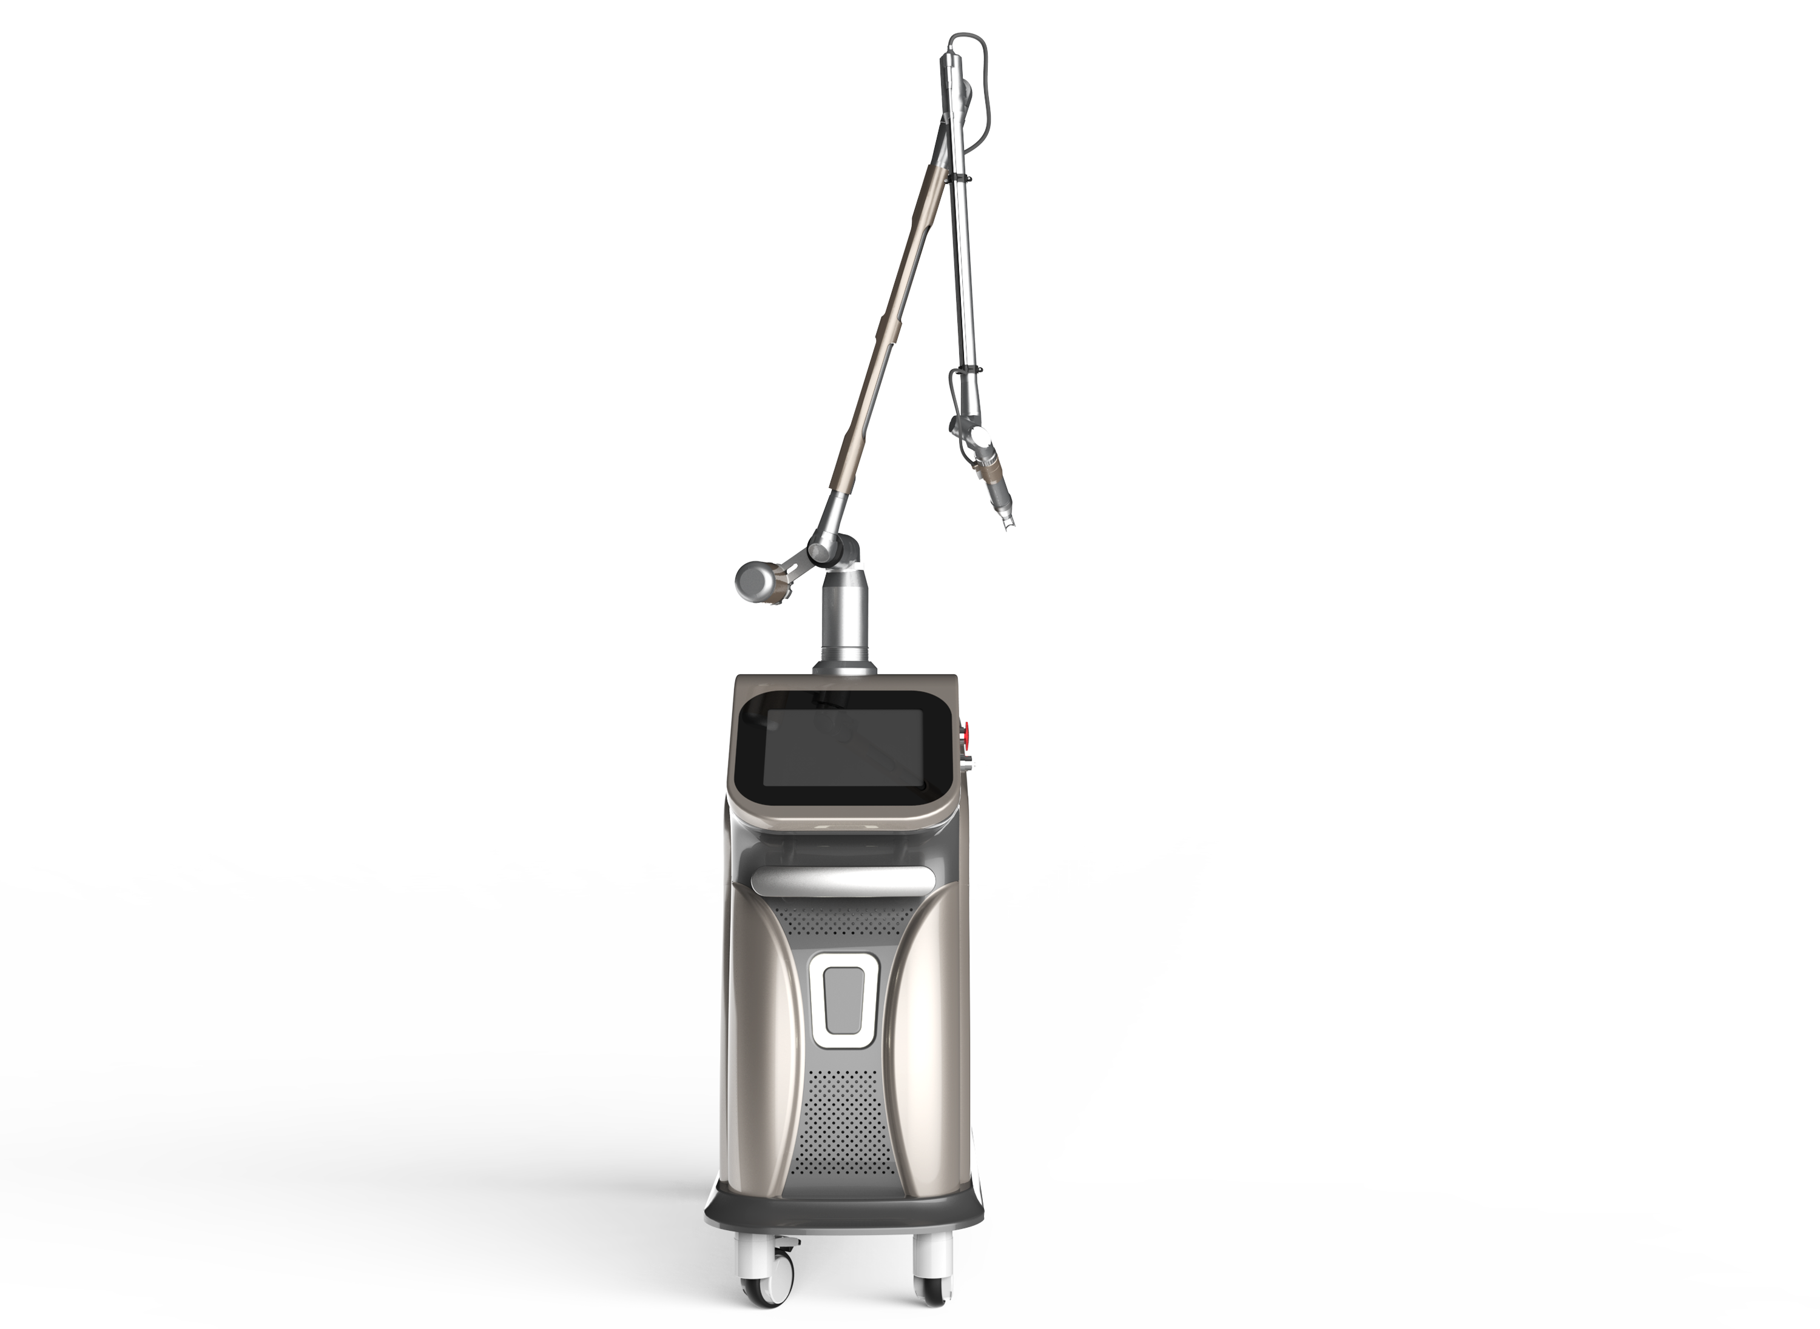
Treatment Range
Freckles, Black spot, Age spots ,Coffee spots and
sun-burn spots.
Body tattoo, eyebrow tattoo and lips line
1
4
Pigment of epidermis and derma layer
Skin rejuvenation, skin whitening and resurfacing.
2
5
Cleanse skin oil and shrink pores
Nevus of Ota and birth mark
3
6

Slide 7
Technical Specification
Laser Type:
Pico second ND: YAG Laser
Energy Level:
Wavelength:
Pulse Duration:
Repetition frequency:
Spot size:
Lamp Quantity:
Dimension:
Weight:
Single mode: Max 400mj (532nm), Max 800mj (1064nm)
Double Mode: Max 800mj(532nm), Max 1600mj (1064nm)
1064nm, 532nm
750ps
1-10Hz
2-10MM
1 lamp 1 rod / 1 lamp 2 rod
90×45×170cm
105kg

Slide 8



Treatment Range
Q & A How many treatment are necessary?
The number of Picosecond laser treatments for unwanted pigmentation will vary depending on the condition being treated and how each individual responds.
For tattoo removal, the size, location and density of ink play important roles in how quickly clearance can be achieved, but 3-4 treatments is common for modern tattoos.

Slide 9
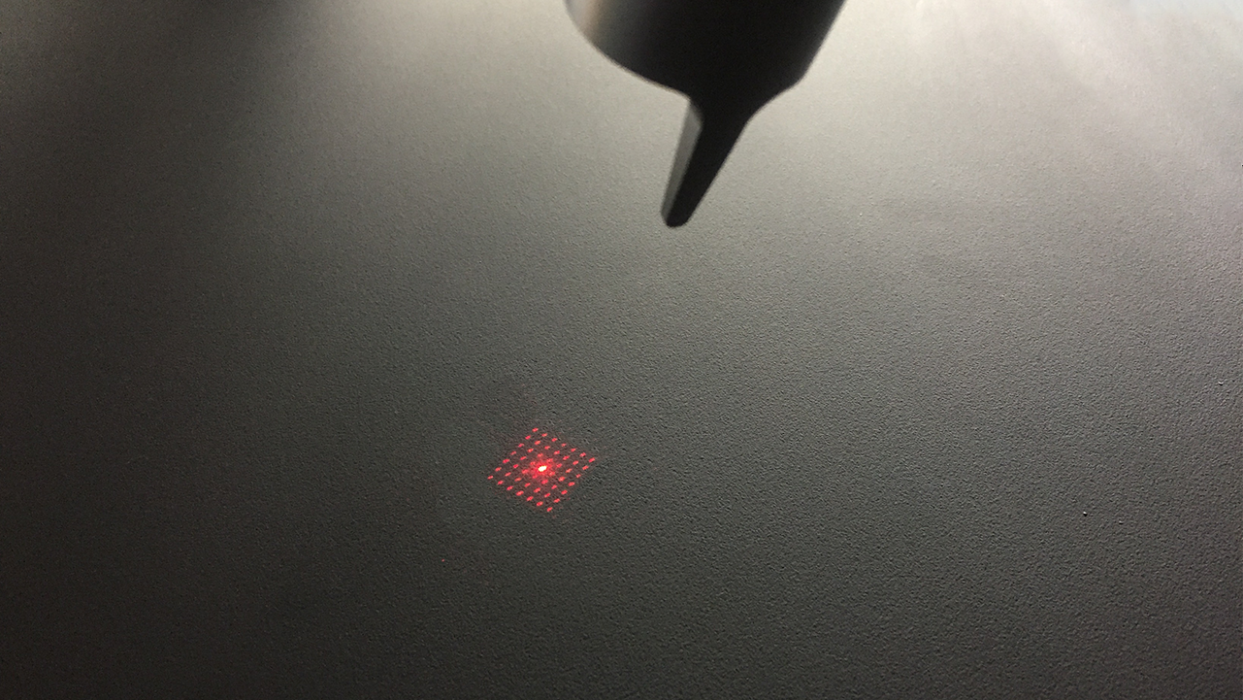

How long does the result last?
Tattoo remova results are permanent. Skin rejuvenation treatment results are long lasting, but some pigment conditions can be recovered
Will be there scarring?
Pico-second laser is designed with safety , and the scarring are very little. Tattoo removal treatments require higher energy than skin rejuvenation and some patients may experience hypo pigmentation but this is usually temporary

Slide 10
What is recovery time?
Recovery times are dependent on the condition being treated and each patient’s ability to heal. usual treatment intervals are 6 weeks for tattoo and 6-8tattoo removal. Treatments for acne scars and skin rejuvenation using the fractional lens which can be performed every 3-4 weeks.
Is Pico second laser safe?
Pico second laser ultra-fast pulses work to minimize the amount of heat that is transferred. Less heat means less damage to surrounding skin and less risk of damage

Slide 11
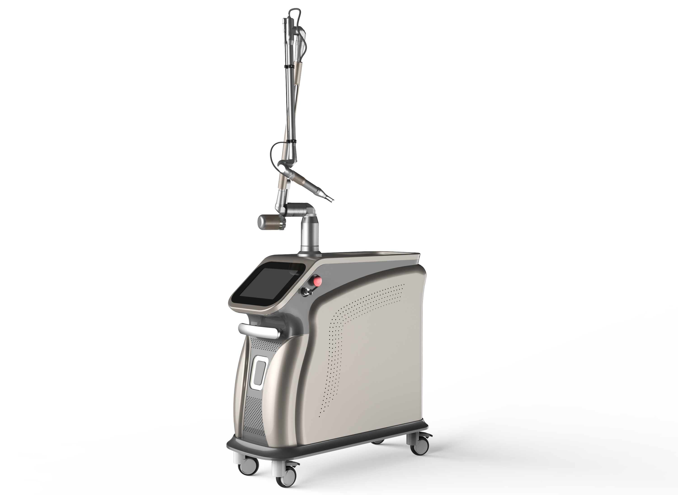
Do I have to avoid the sun after the treatment?
After laser treatments for l tattoos removal and unexpected pigment, the skin is more easily damage to sunlight.So minimizing sun exposure and use of sunscreen of SPF30+ is recommended.
How long does the procedure take?
It depends on the size of the area to be treated, and 10 minutes is common for average sized tattoo and skin rejuvenation treatments

Slide 12
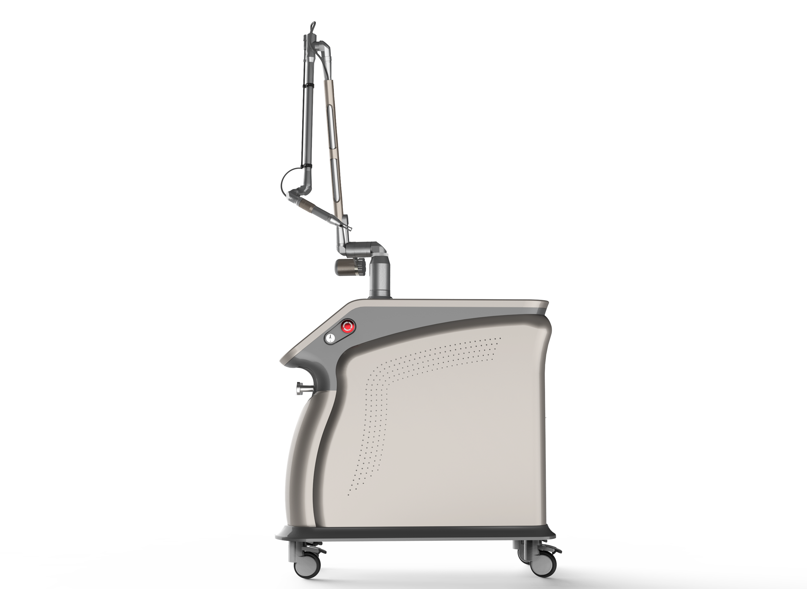
What does pico second laser feel like?
Most people experience very little discomfort and describe skin rejuvenation treatments as feeling like the snapping of a rubber band. Because tattoo removal treatments use more energy, patients may experience more discomfort, but your treatment provider should be able to offer numbing cream or other aids to minimize discomfort

Slide 13
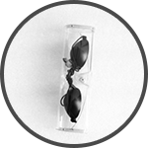
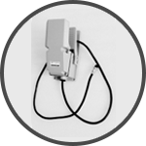

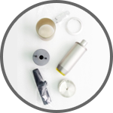
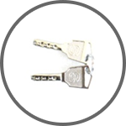
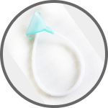
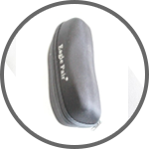
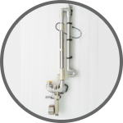
Accessories List

Slide 14
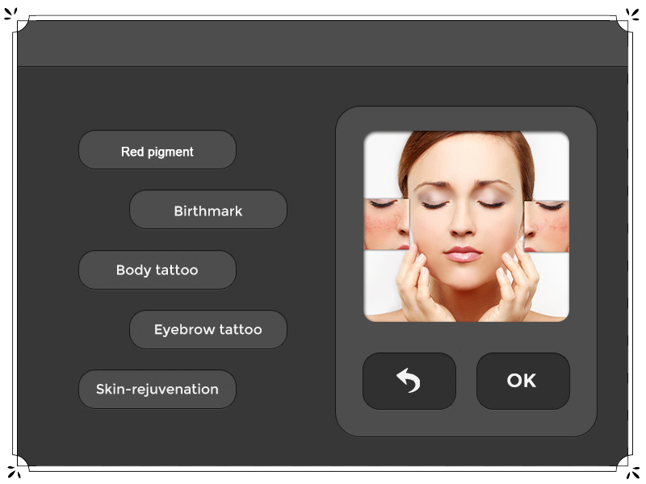
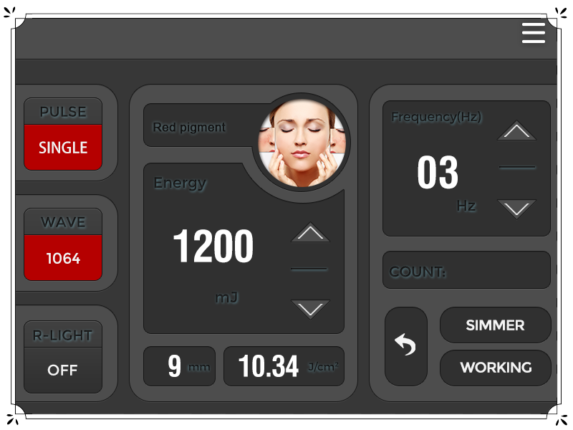
User-friendly Interface

Slide 15
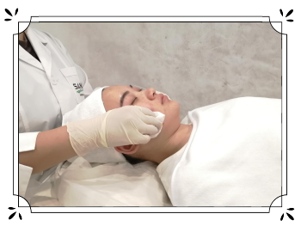
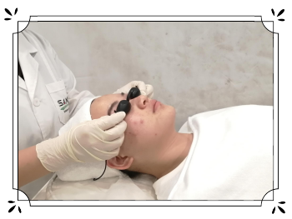
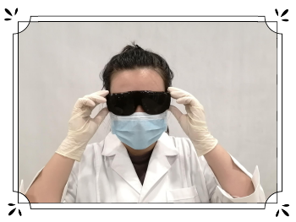
Treatment steps
1
2
3
Clean the treatment area
Customers put on Eyegoogle
Operator puts on goggles

Slide 16
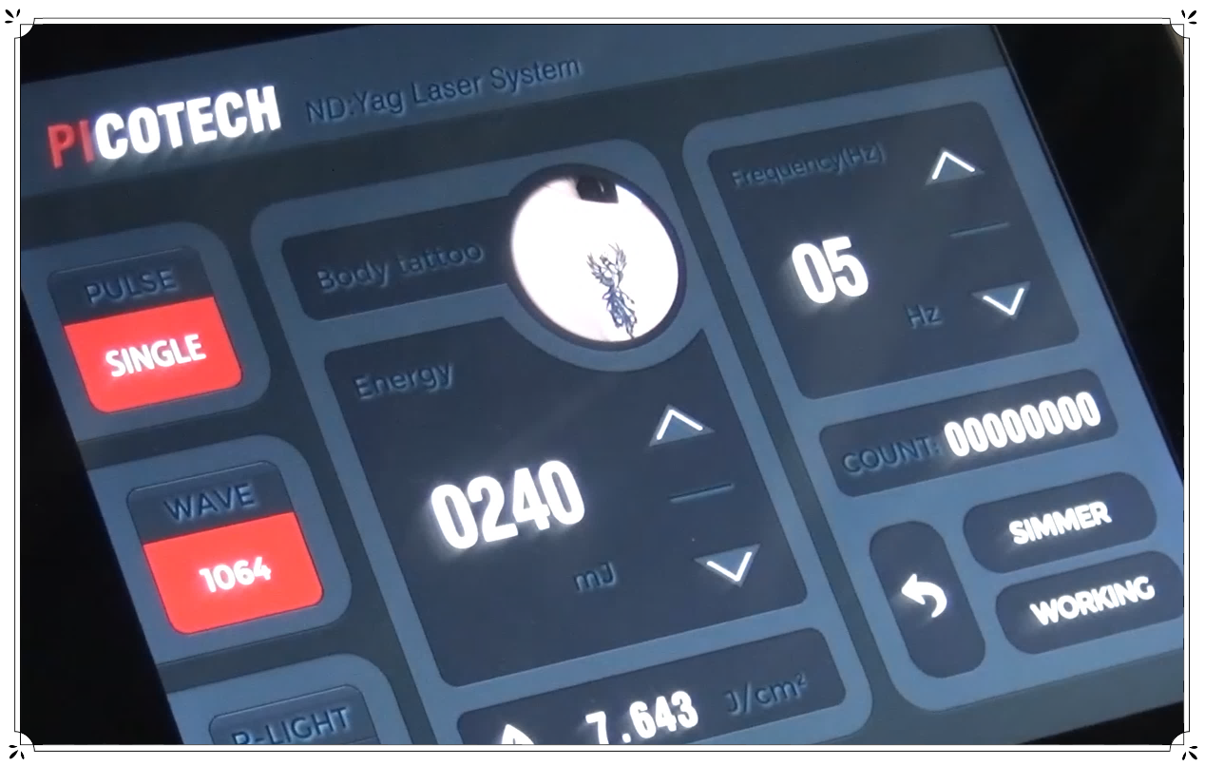
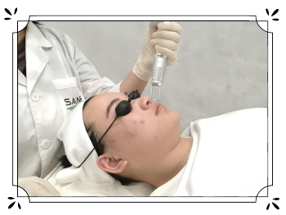
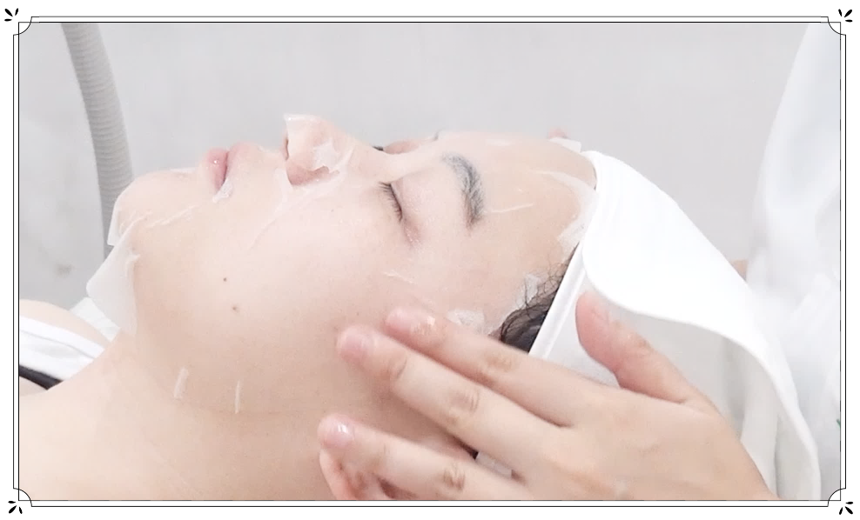
Treatment steps
4
5
6
Adjust parameters for treatment
Do treatment
Use medical mask

Slide 17

Before & After
Before
After
Before
After
Before
After
Before
After

