Slide 1
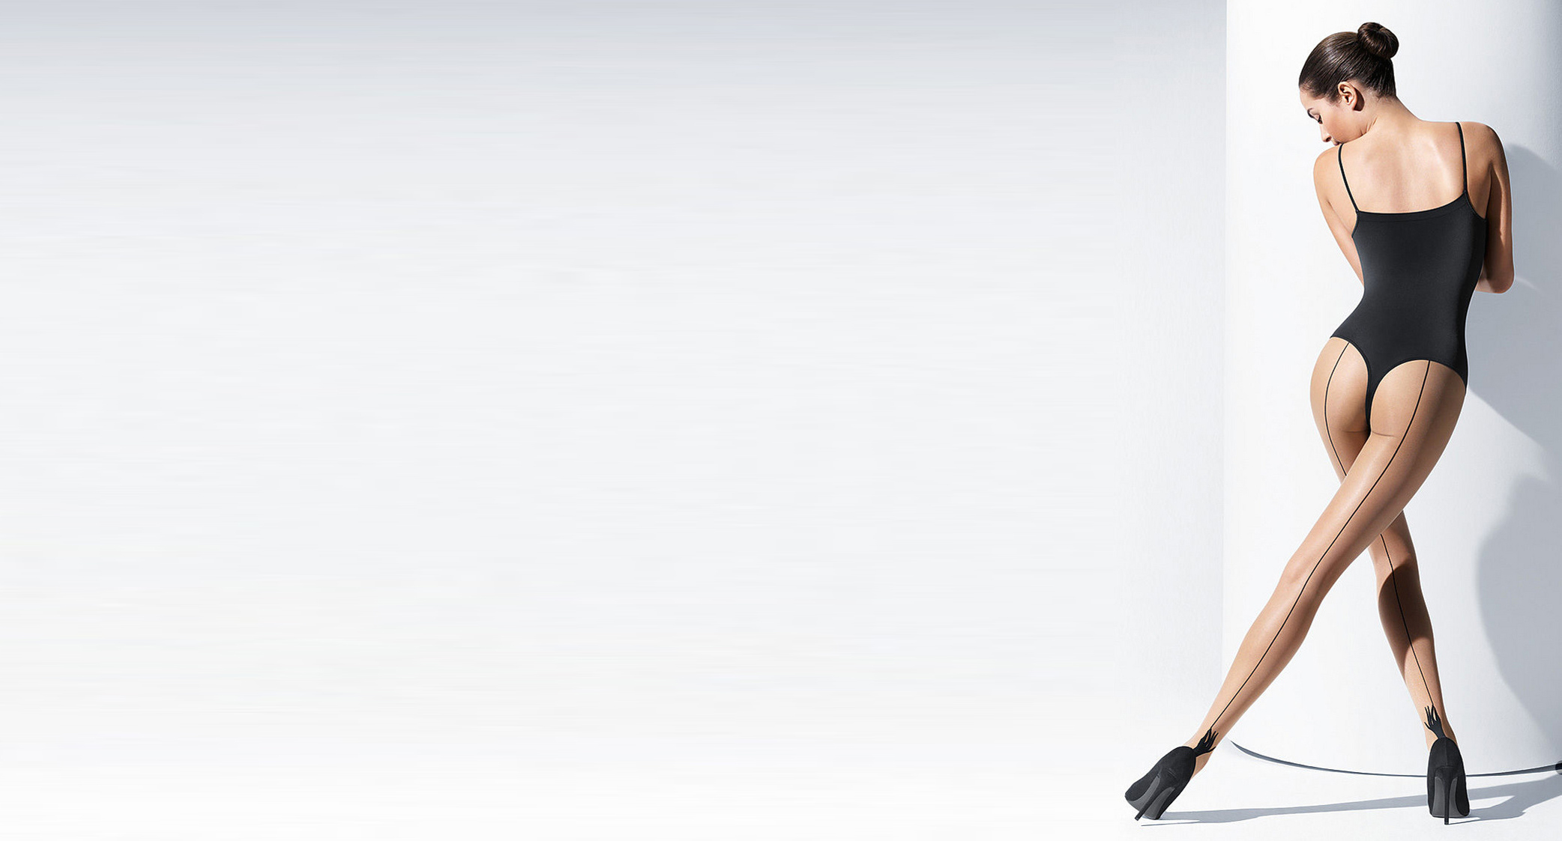
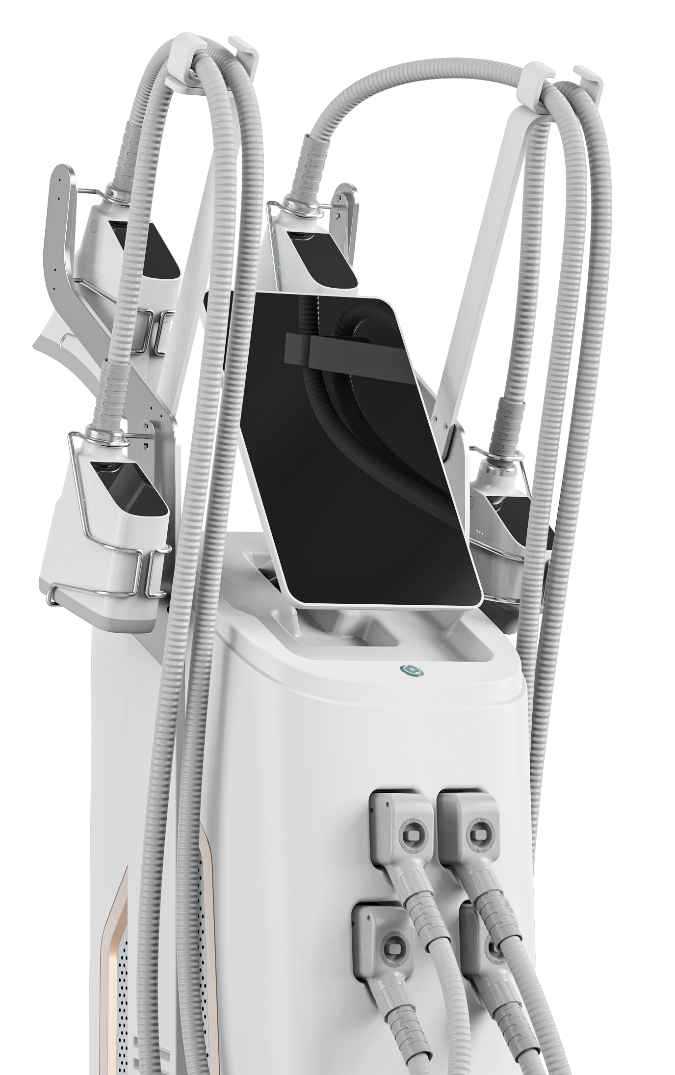
360°Cryolipolysis Cryocool
The Newest Generation Applicator

Slide 2
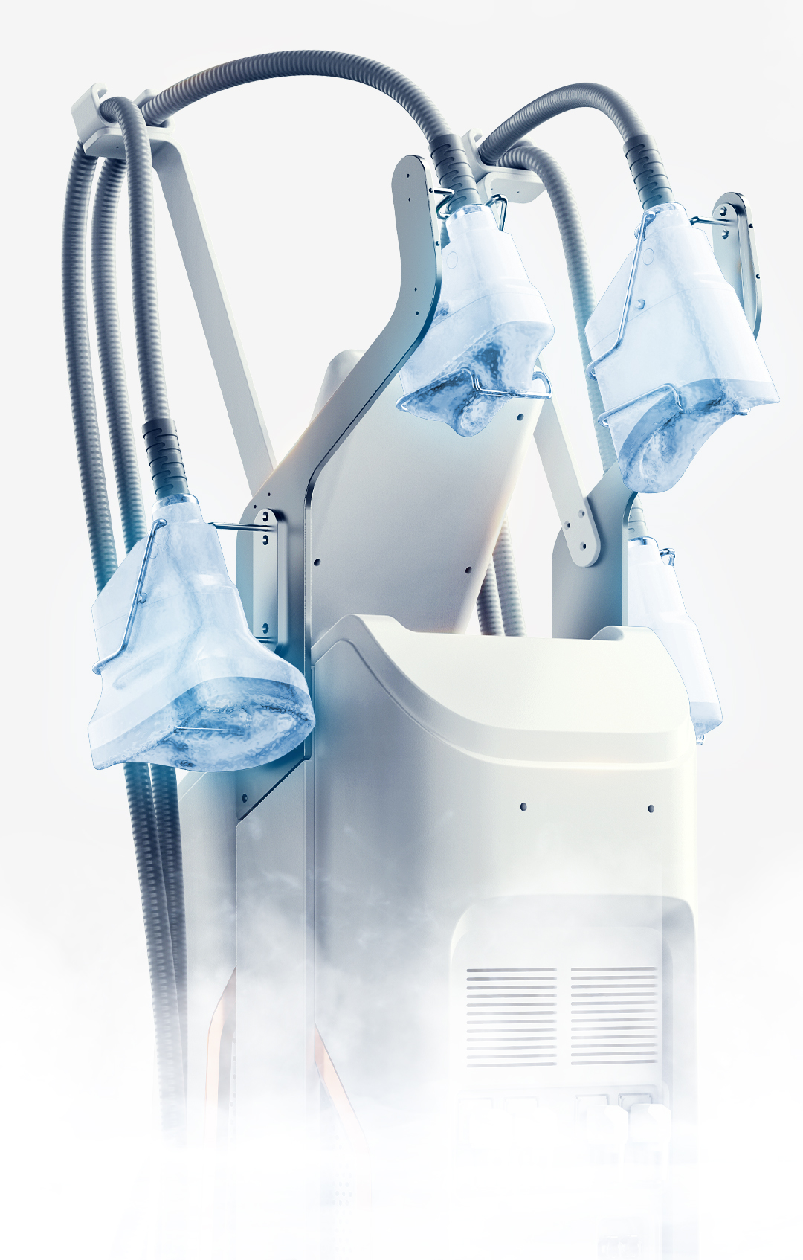
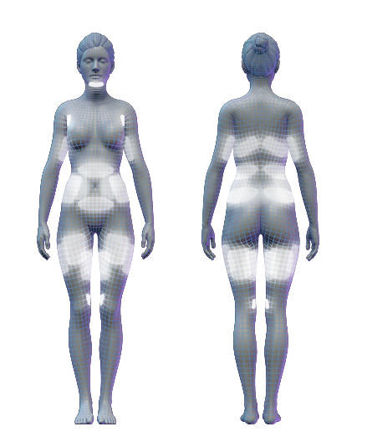
5 APPLICATOR full body Shaping
Double Chin &
Under the Jawline
Bra Fat
Upper Arm
Waist/side
Thigh
Back
Upper Arm
Waist/Back
Around Thigh

Slide 3
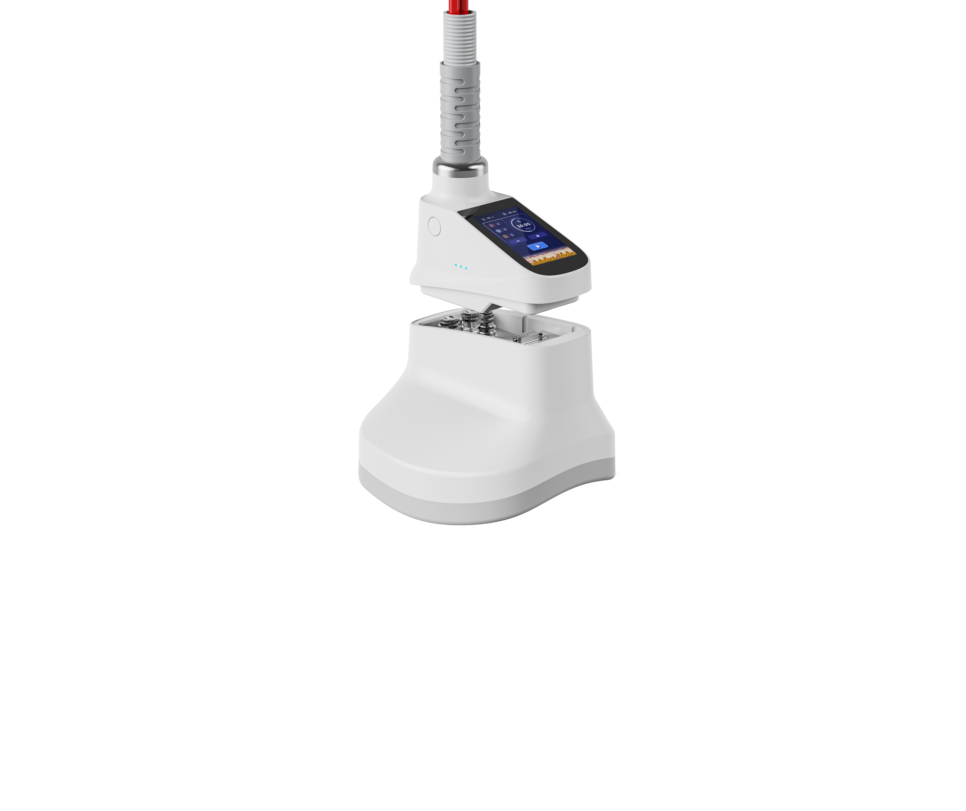
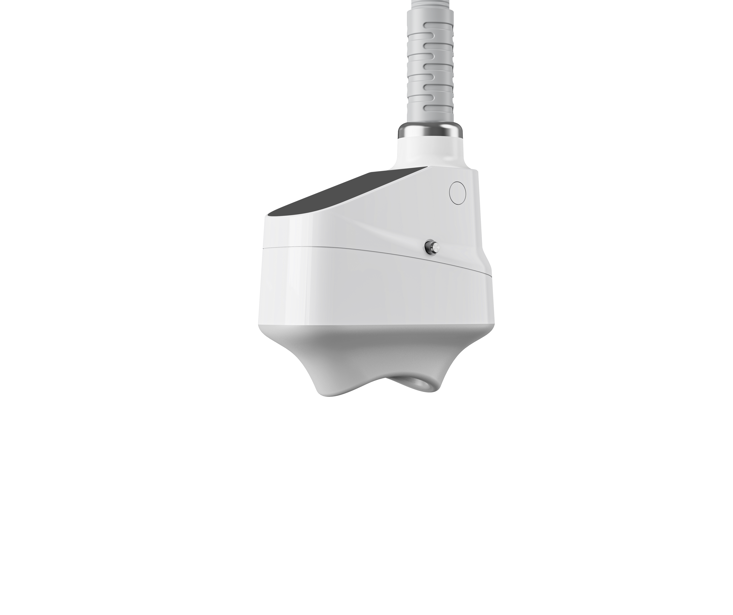
Treatment Head P1
Treatment Head P2
5 applicator
More treatment areas more effective
Treatment Head P3
Treatment Head P4
Treatment Head P5

Slide 4
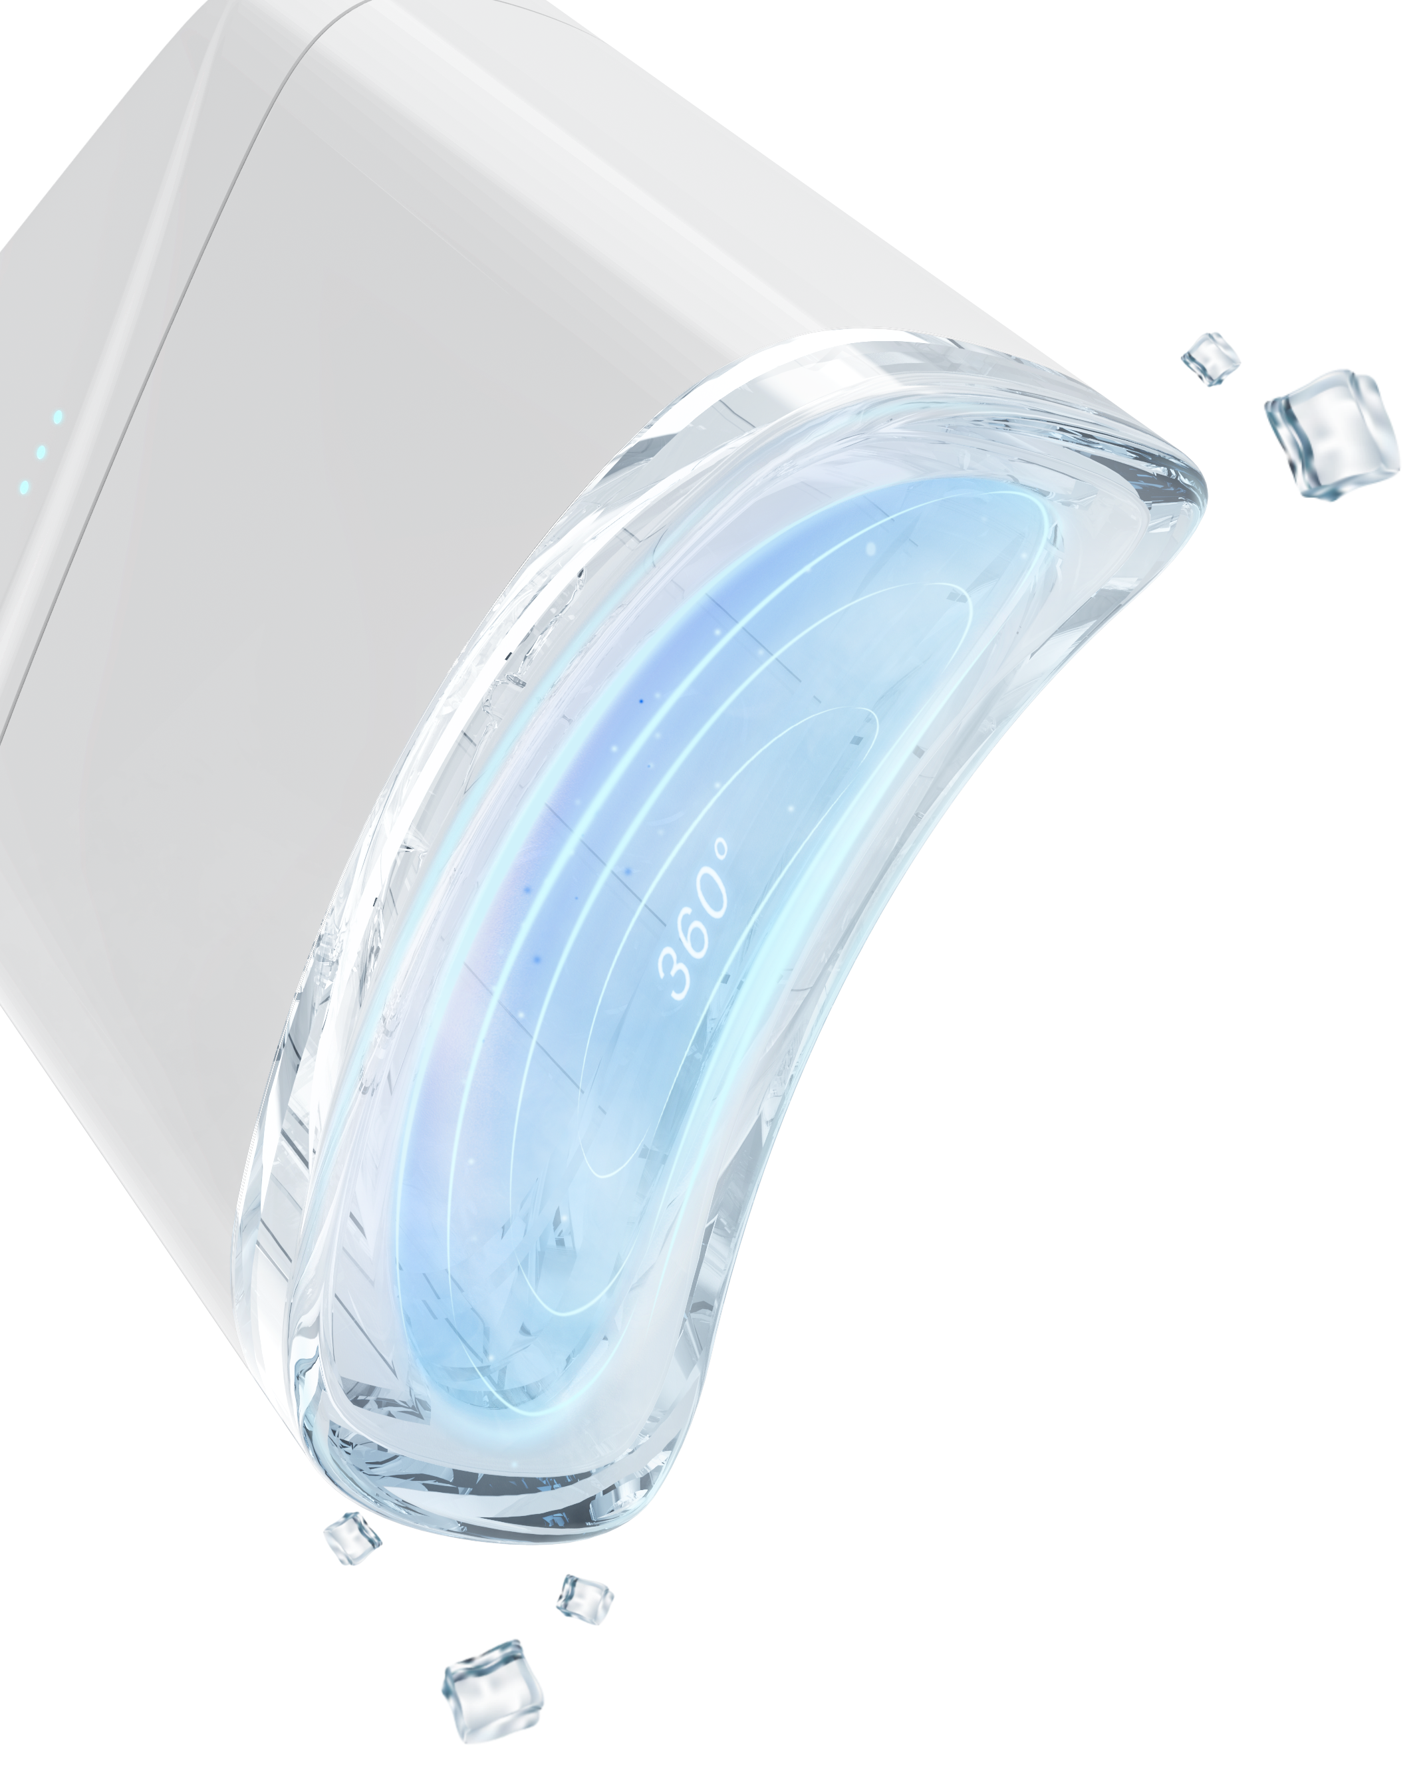
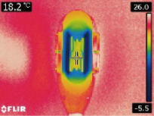
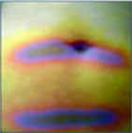
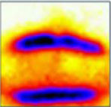
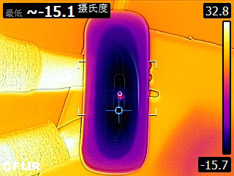
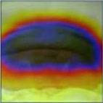
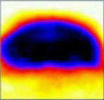
Cooling on both sides
Advantages ^{-12°supper cooling}
Traditional Cryolipolysis by two Chilling Plates, only 40% effective for treatment area
360°cooling
NEW 360° cooling applicator
100% effective for treatment area
The lowest temperature can reach -12 degrees

Slide 5

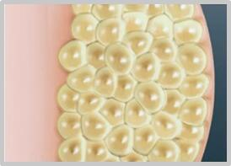
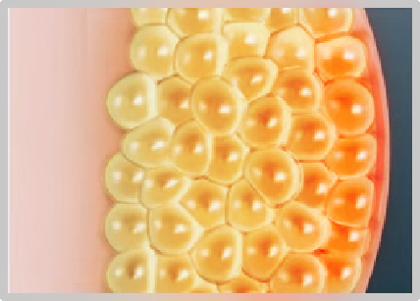
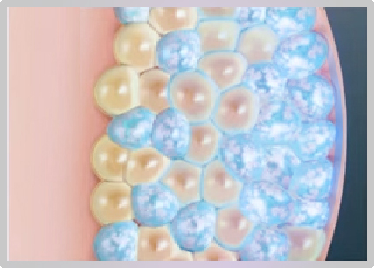
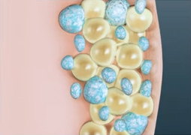
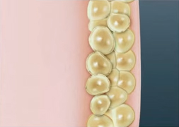
Working Mechanism
After the adipose tissue of the target care site is sucked into the cooling probe, the cooling probe releases a 360-degree surrounding cooling energy to act on the fat cells without damaging any surrounding tissue. Cryocool's steady and powerful cooling energy triggers a natural cell death process called "apoptosis", after which apoptotic fat cells are excreted through the body's natural metabolic process. Cryocool targets fat cells for permanent removal from the body, resulting in significant fat loss in the treated area.
Many of us have stubborn fat despite diet and exercise.
Warm-up technology to accelerate blood circulation
Applicator 360 degrees around fat cells without damaging any surrounding tissue
In the weeks to follow, your body naturally process the fat and eliminates these dead cells.
Cryocool procedure results are long-term, as treated fat cells are gone for good.

Slide 6
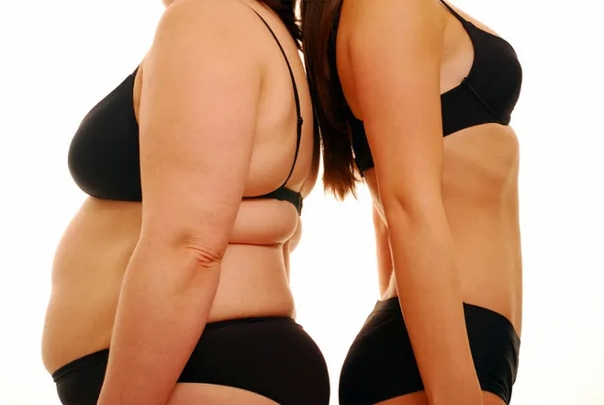
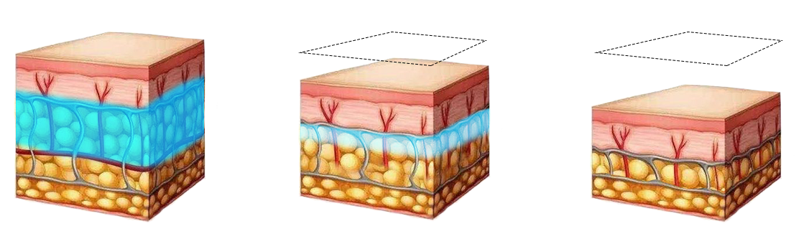
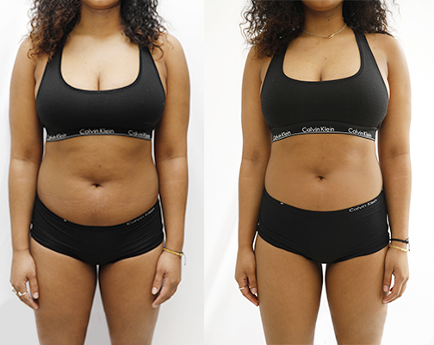
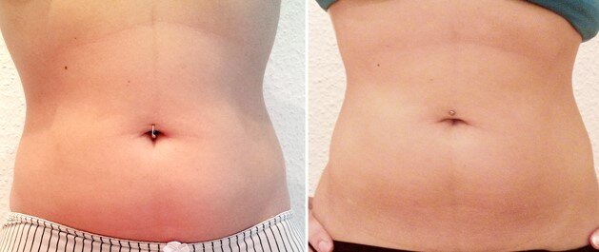
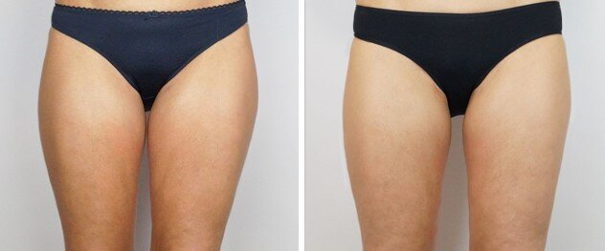
0day
BEFORE & AFTER
30days
90days
Gender: Female
Age: 32
Treatment area: abdomen
Treatments times: 3
Gender: Female
Age: 35
Treatment area: abdomen
Treatments times: 2
Gender: Female
Age: 29
Treatment area: thigh
Treatments times: 4

Slide 7
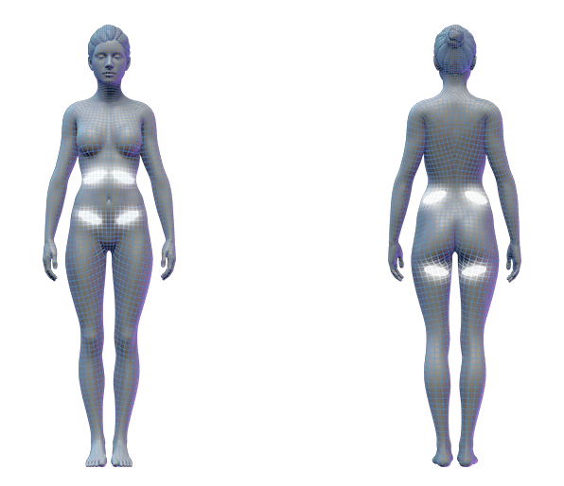
5-1 APPLICATOR
Abdomen/Side
Back waist
Back of thigh

Slide 8
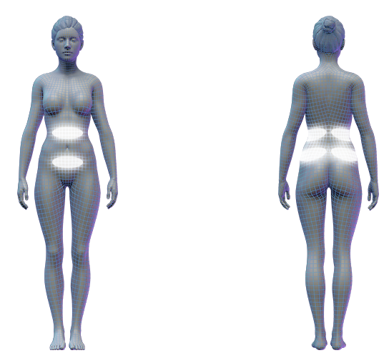
5-2 APPLICATOR
Abdomen
Back

Slide 9
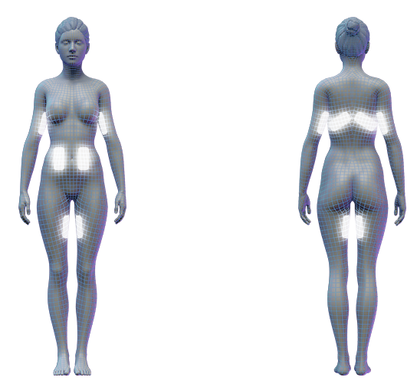
5-3 APPLICATOR
Upper Arm
Abdomen/Side
Back
Thigh

Slide 10
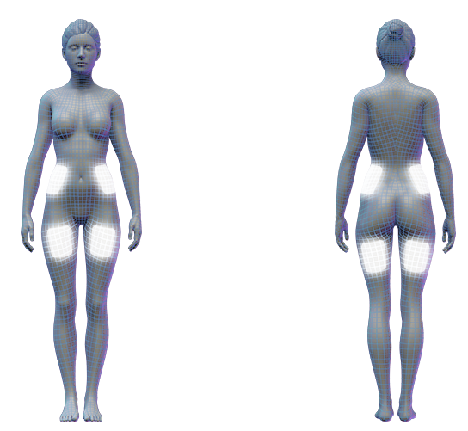
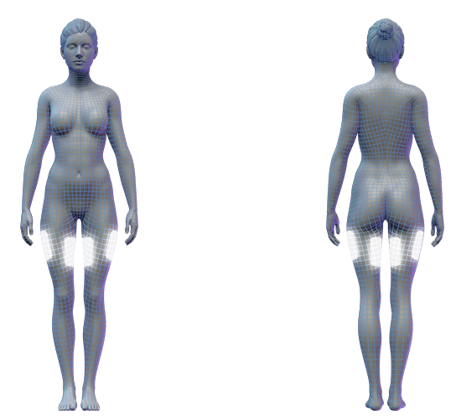
5-4 APPLICATOR
Thigh(front, back, left and right)
Waist side

Slide 11
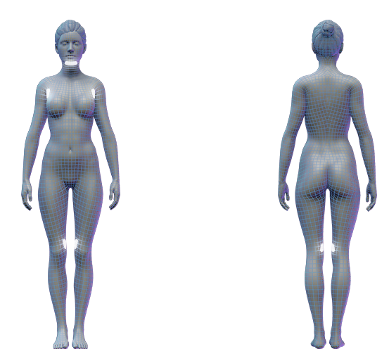
5-5 APPLICATOR
Double Chin
Bra Fat
inside of knee

Slide 12
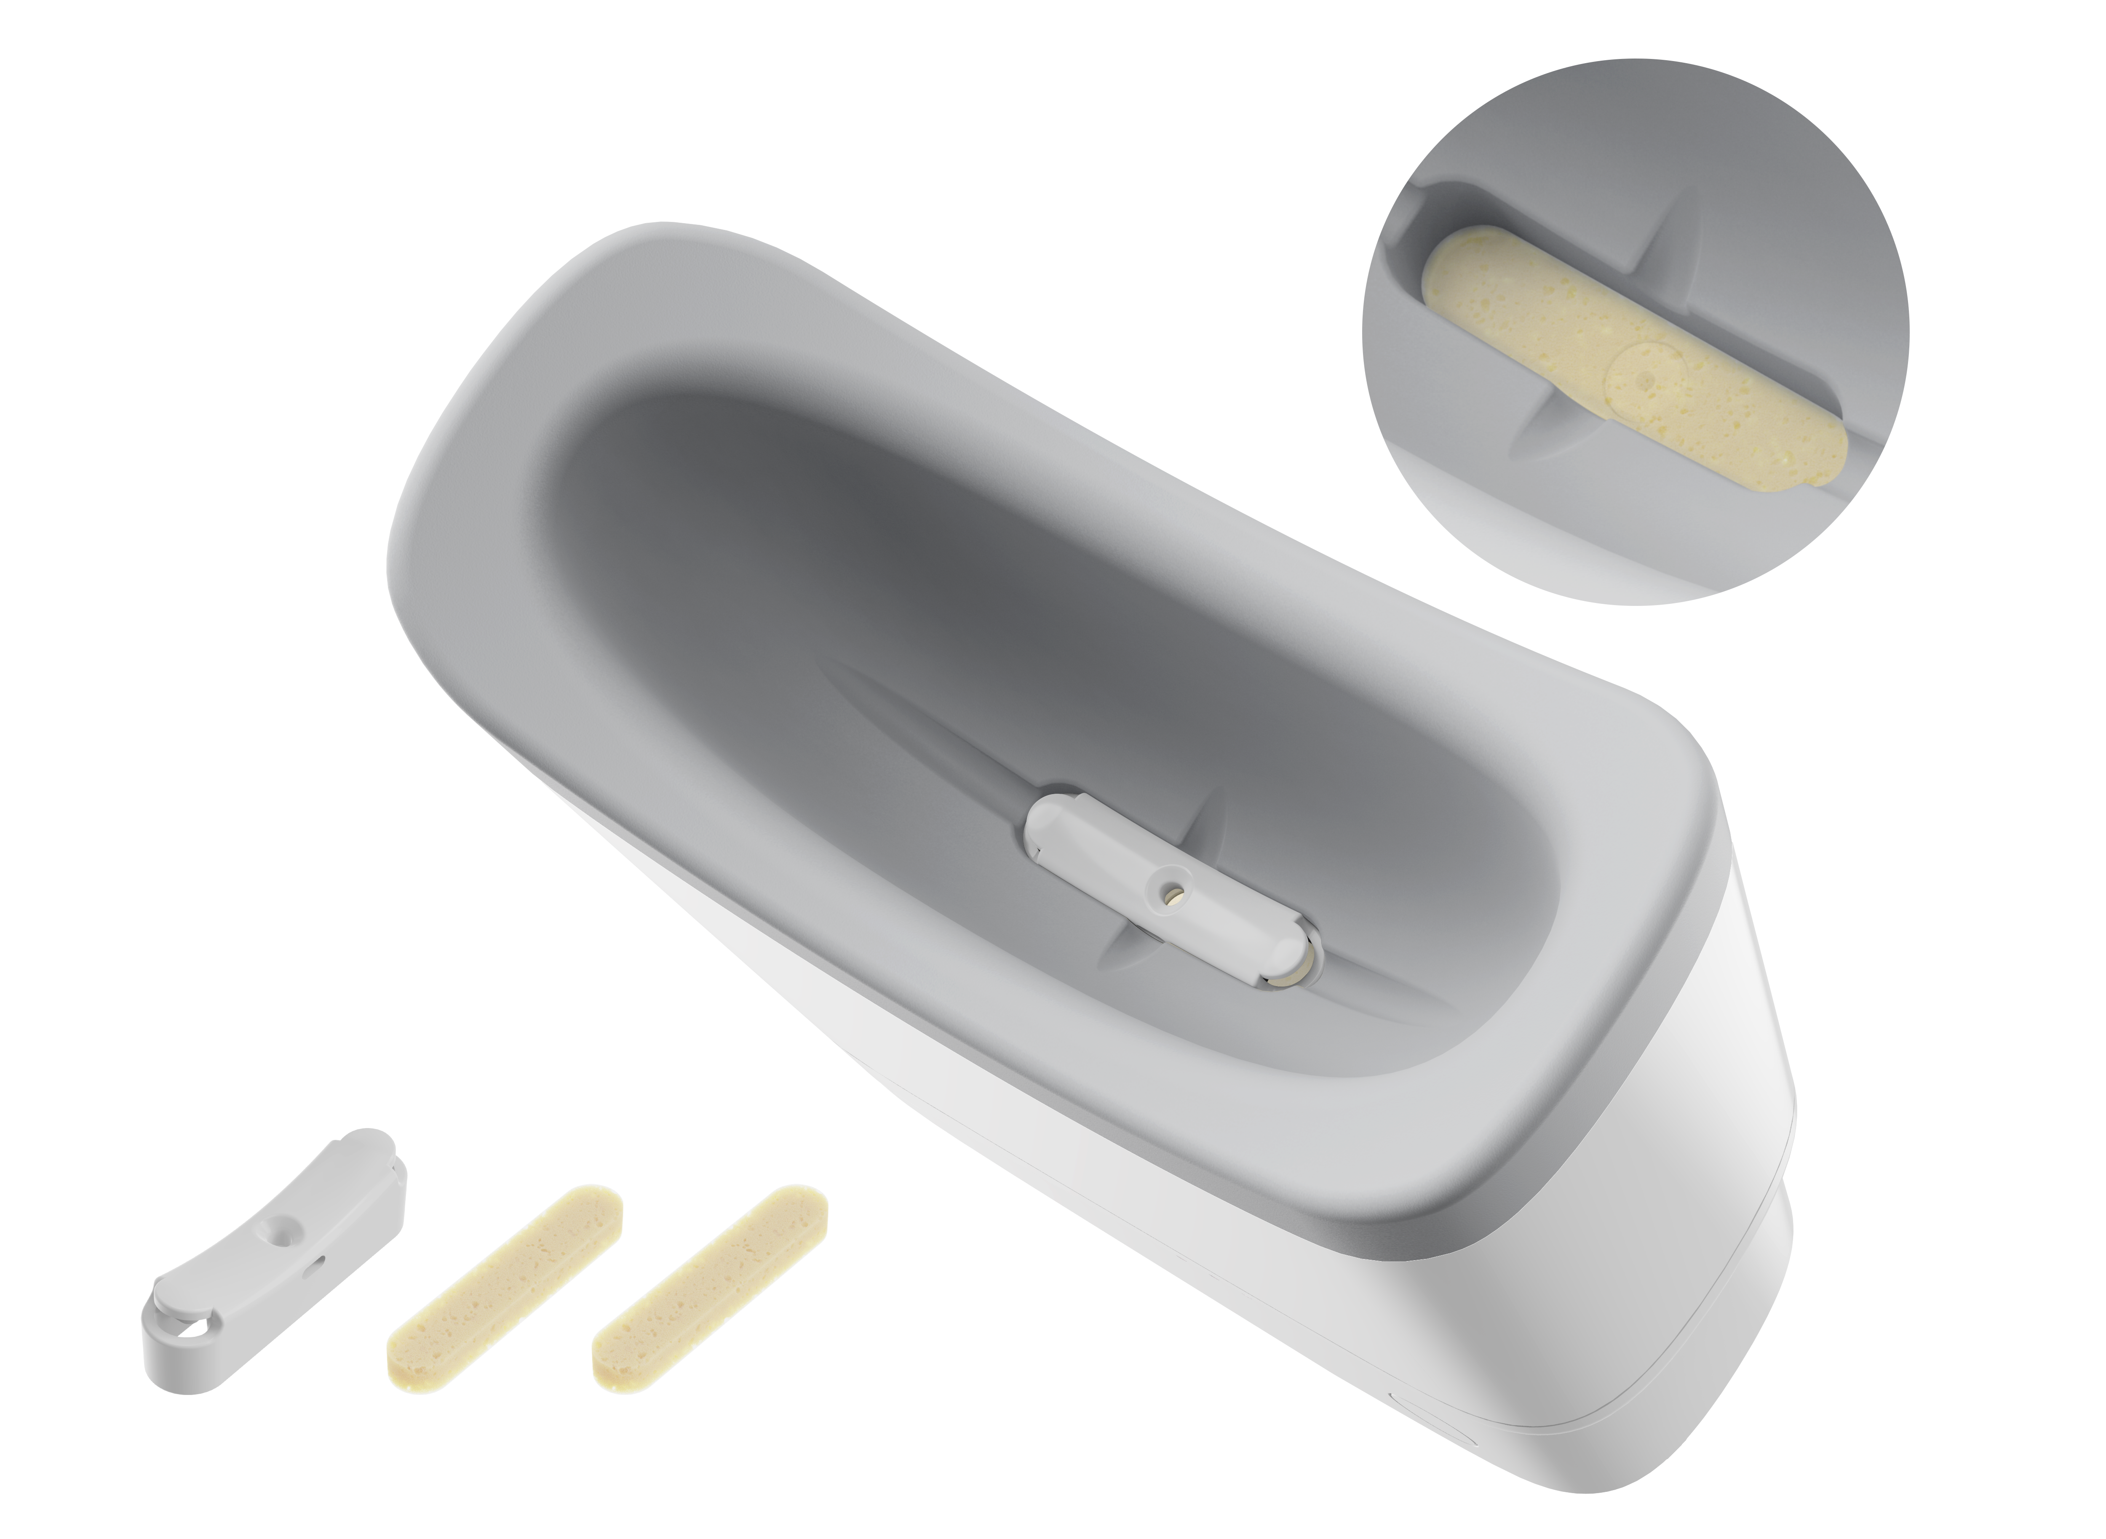
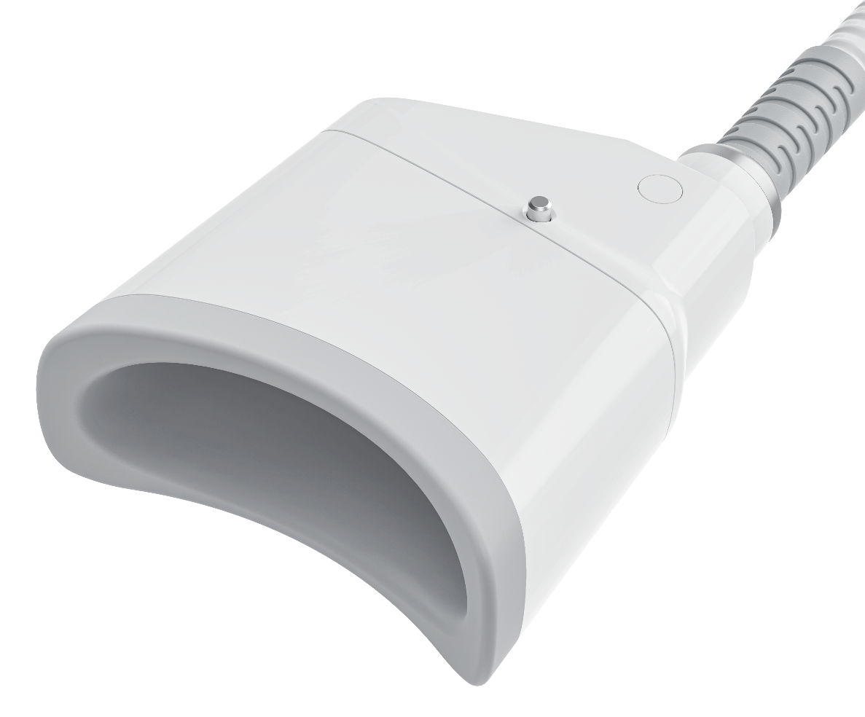
Advantages
Medical silicone, safe and comfortable
Medical filter cotton, effectively filter debris

Slide 13
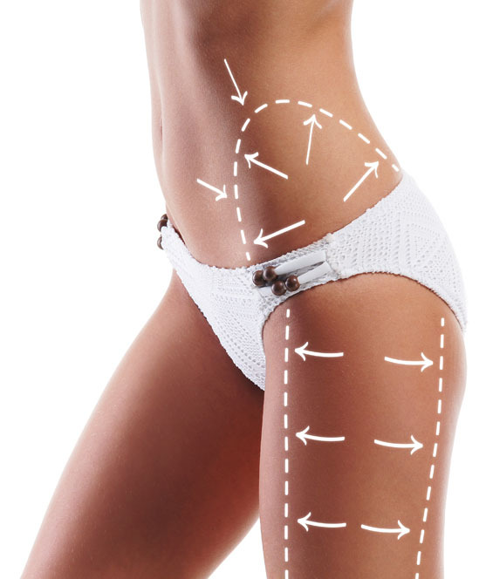
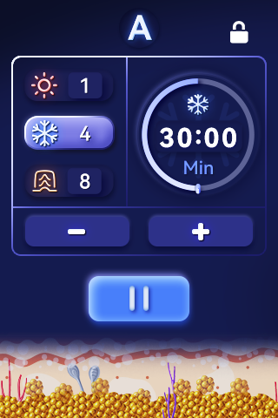
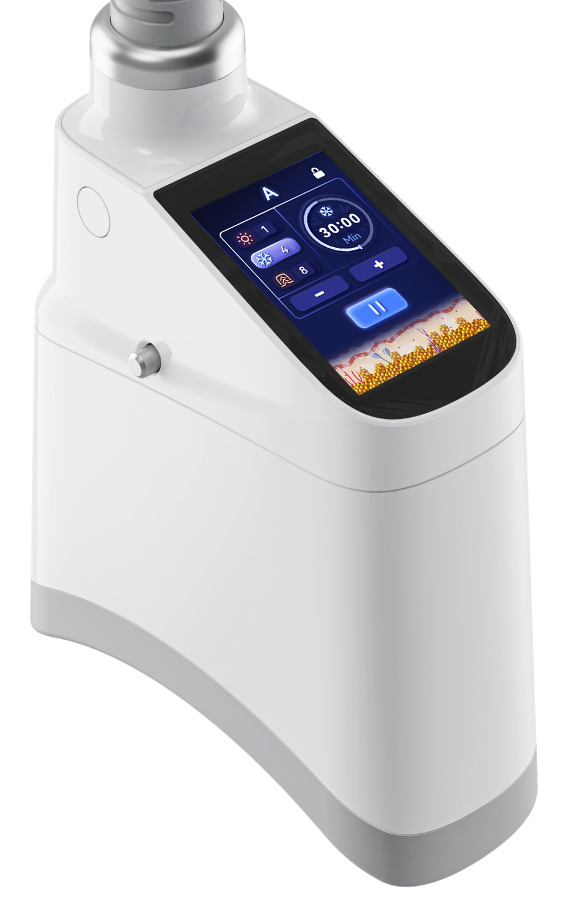
Advantages ^{Humanized toouch screen}
Lock/Unlock
heating
Cooling
Time
Vacuum
Start/Stop

Slide 14
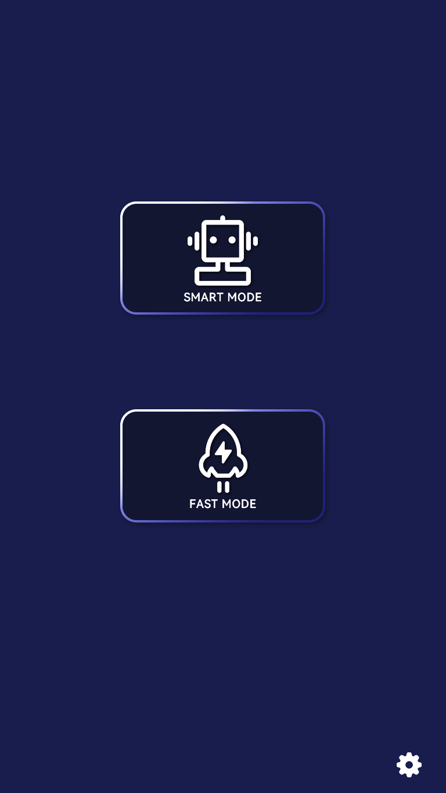
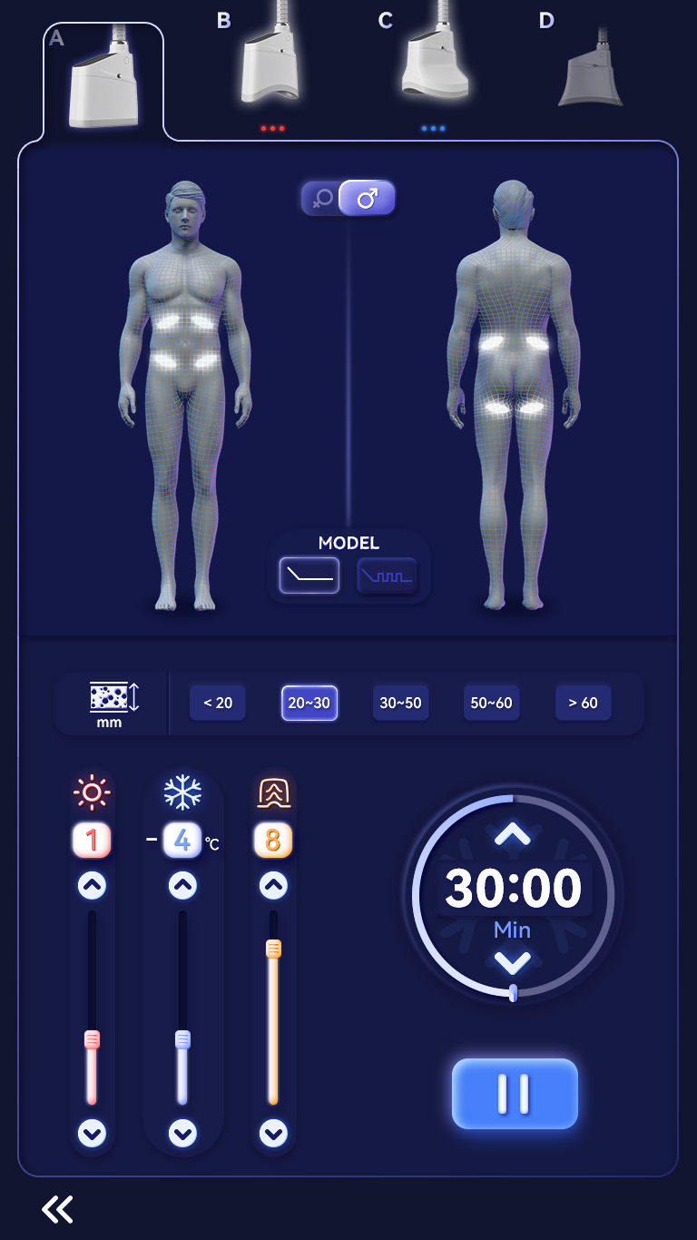
UI Interface
Select different size applicator
Smart mode
Select cooling mode
Fast mode
Choose fat thickness
Set treatment time
Start/Stop
Adjust vacuum level
Adjust temperature
(cooling/heating)

Slide 15
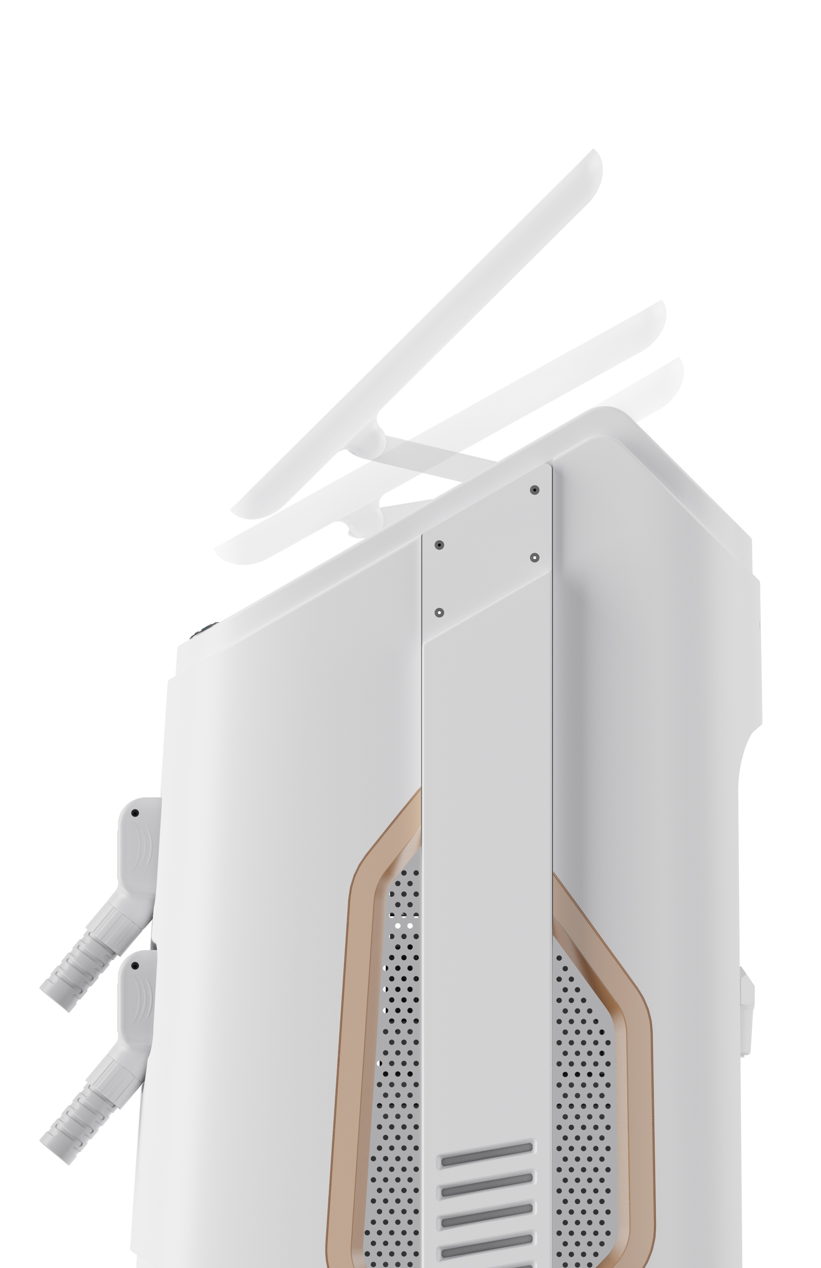
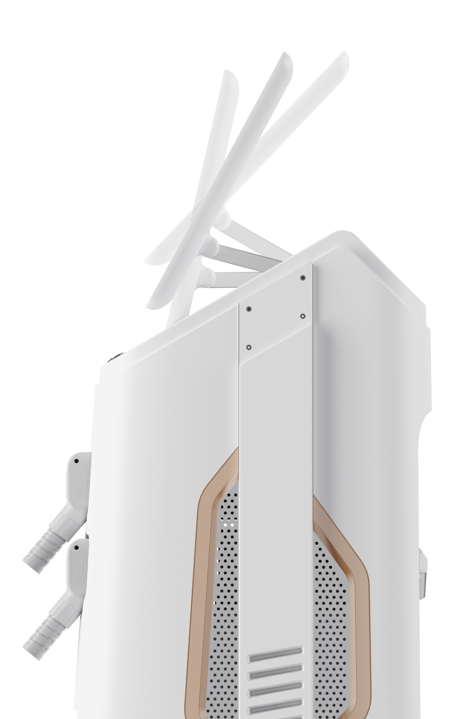
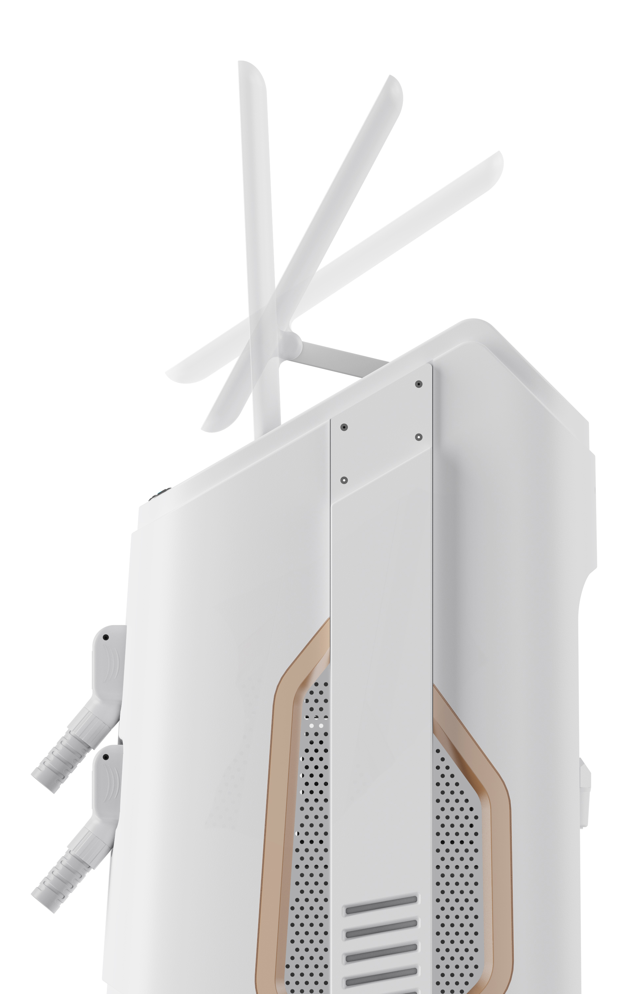
Advantages ^{foldable screen}
60°
45°
30°

Slide 16
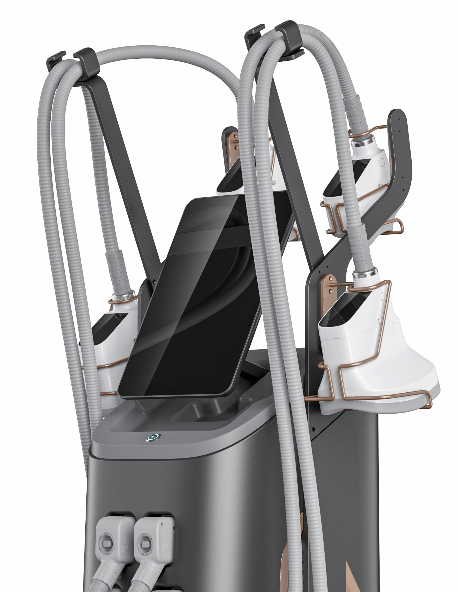
Specification
Input power: |  | 1200W
Frozen Head Pressure: |  | 0-60Kpa
Frozen Head Screen: |  | -12°C -1°C
Treatment Handle’s Type: |  | 5 applicator in different size
Machine Screen: |  | 15.6 inch Collapse screen, 30°-73° adjustable.
Cooling System: |  | Semiconductor cooling + water cooling +air cooling
Dimension: |  | 41*58*154cm
360 CRYOLIPOLYSIS CRYOCOOL

Slide 17
0day
BEFORE & AFTER
30days
90days
Gender: Female
Age: 32
Treatment area: abdomen
Treatments times: 3
Gender: Female
Age: 35
Treatment area: abdomen
Treatments times: 2
Gender: Female
Age: 29
Treatment area: thigh
Treatments times: 4

Slide 18
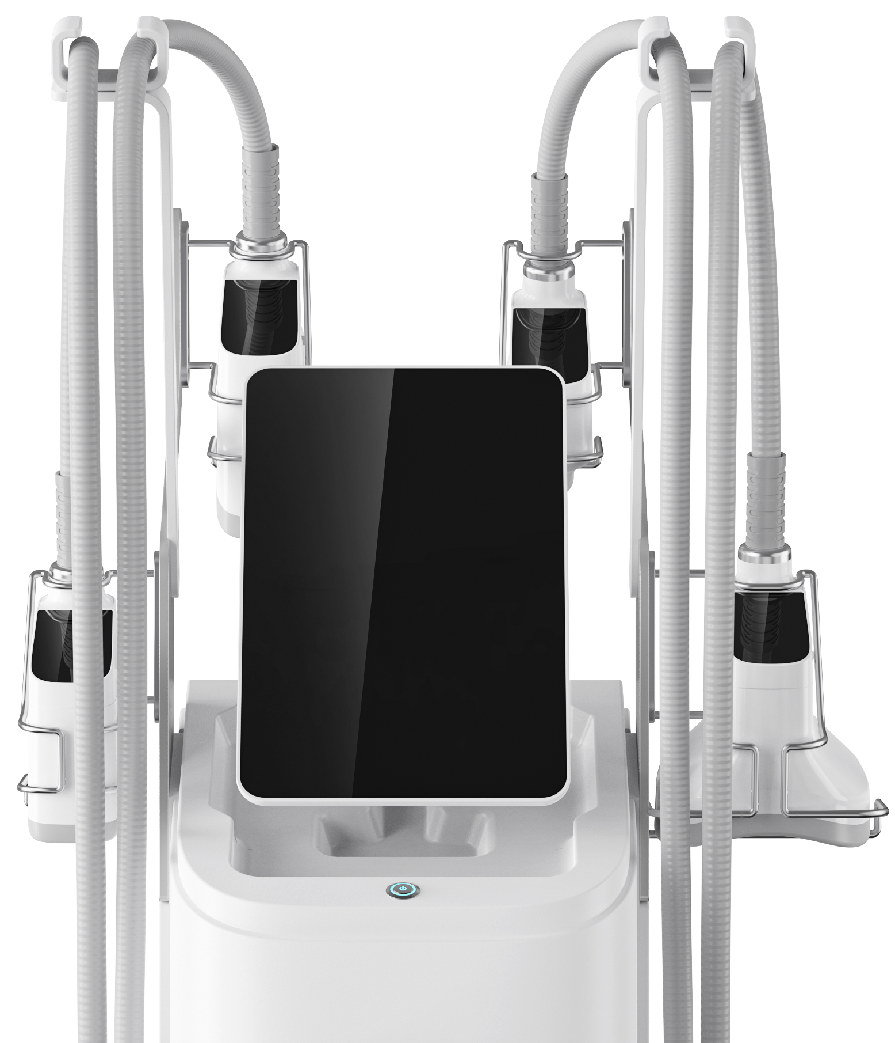
360° Cryolipolysis Cryocool

