Slide 1

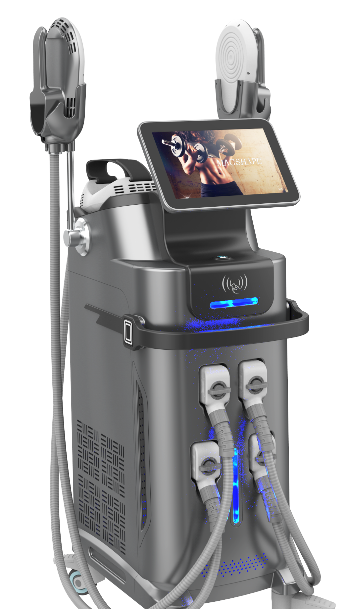


HI-EMT MAGSHAPE
LESS
Fat
Muscle
MORE

Slide 2
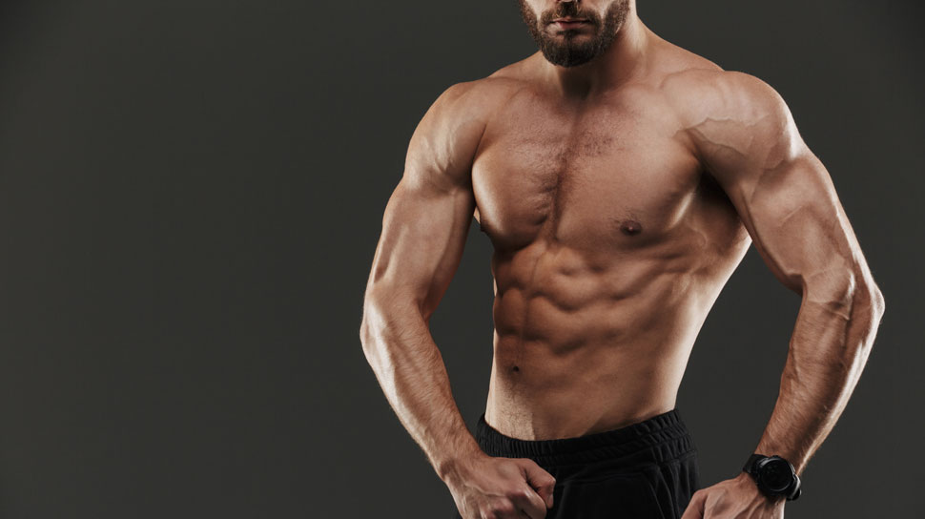
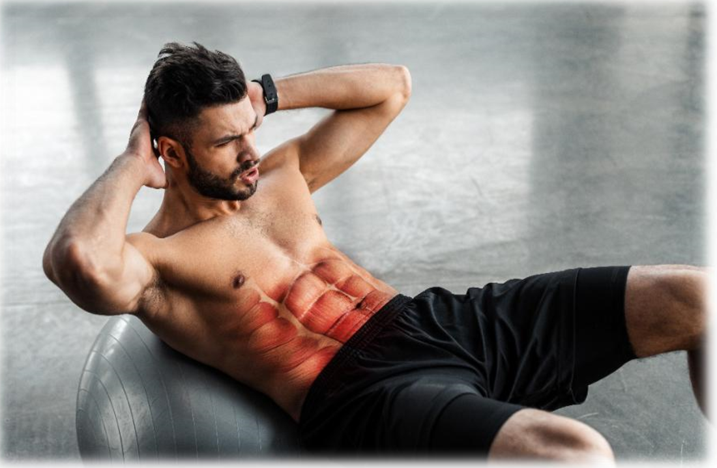
HI-EMT Technology
Electromagnetic field of HIEMT can target motor nerve cells to generate action potential, which directly stimulates muscle contraction. It can be said that "you can do exercise while lying down."
During the 30minute treatment, the muscles are contracted over 30,000 times with high frequency and high intensity, which cannot be achieved in general exercise!
Muscle extreme contraction requires a large amount of energy supply, so the fat cells next to the muscle are also consumed, leading to natural apoptosis and reducing fat thickness effectively.
Muscle movements caused by HIEMT will not damage other joints or bones of the body, and it can effectively strengthen the muscles of the abdomen or buttocks, increase the number and volume of muscle fibers. It makes the body lines more prominent, "mermaid line“ and " The vest line” clearer.

Slide 3

MAGSHAPe
Magshape is the only procedure which helps patients build muscle and sculpt the body at the same time. Feel like an intensive exercise, good for health.
It is suitable for shaping, gaining muscle, dissolving fat, exercising vest lines and raising hips.
It provides the world's first non-invasive hip lifting procedure. Non-invasive and requires no recovery time or any pre/post treatment preparation.
Based on high-intensity focused electromagnetic energy. A single Magshape session causes thousands of powerful muscle contractions which are extremely important in improving the tone and strength of your muscles.
It works by super-maximal contraction: muscle tissue is forced to adapt to this extreme condition.
It responds by a profound transformation of the internal structure, which leads to muscle accumulation, tension, conditioning and burning fat.
By reducing abdominal fat and at the same time building a muscle foundation under the fat, it helps patients achieve a slimmer and more athletic body contour.
The recommended treatment plan: 20-30 minute treatment with minimum of 4 sessions scheduled 2-3 days apart. Your provider will help you create a treatment plan tailored to your specific goals.

Slide 4
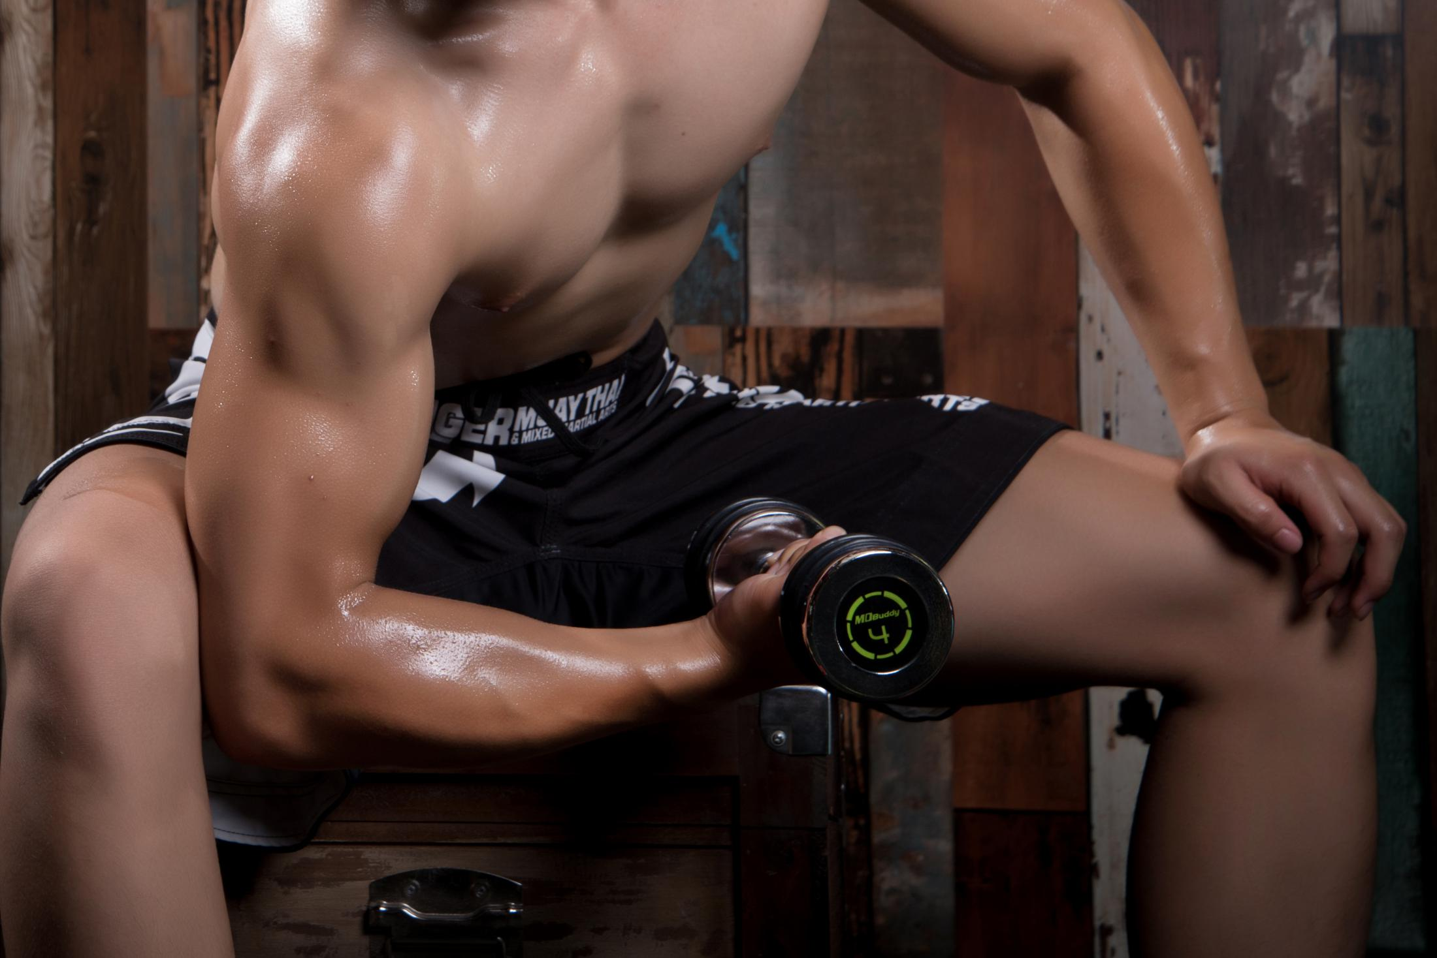
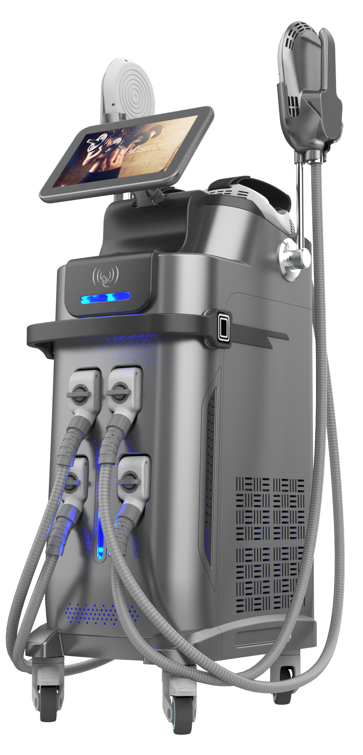

Magshape - 4 Handles
Treat 4 areas at the same time
30 20.000
=
Mins Treatment
Workouts
16%
Average
increase in
muscle mass
19%
Average
fat reduction

Slide 5

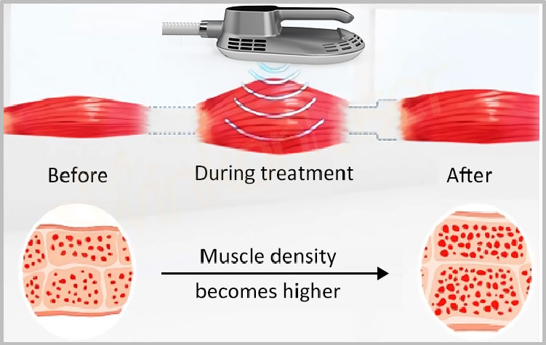
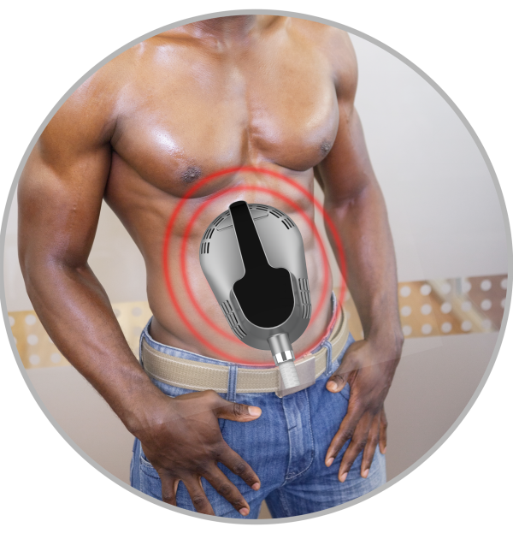
Core principles
Through HI-EMT (high energy focused electromagnetic wave) technology, autologous muscles can realize the ultimate training of continuous expansion and contraction, so as to deeply reshape the internal structure of muscles. It promotes the growth of myofibrils (muscle enlargement) to produce new protein chains and muscle fibers (muscle hyperplasia) and increases muscle density and volume through training.
Under Hi-EMT technology, the 100% limit muscle contraction movement can cause a large amount of fatty acid decomposition, fatty acid from the triglyceride decomposition outflow, in the fat cell a large amount of accumulation. Fatty acid concentration is too high, allowing adipocyte apoptosis, in a few weeks by the body normal metabolism out of the body.
So HI-EMT can strengthen and increase muscle, at the same time accomplish reducing
fat effectively.
A specific range of frequencies that do not allow the muscle to relax between successive stimuli, forcing the muscle to remain contractive for several seconds.Muscle formation occurs when muscle tissue is repeatedly exposed to these high load conditions.

Slide 6

Advantage
Building muscles and burn fat together
Non-invasive hip lifting
Suitable for everyone-no anesthesia-no surgery
Short-term treatment, one time 30 minutes
Only 4 sessions are required between 2-3 days
Feels like an intensive exercise
Safe without downtime
The result is immediate, but it will be noticeable after two to four weeks.
Muscle mass increased by an average of 16%
Average fat loss 19%

Slide 7

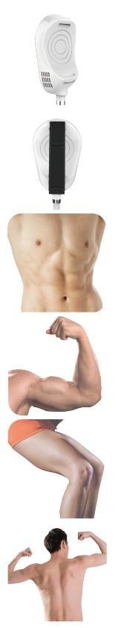
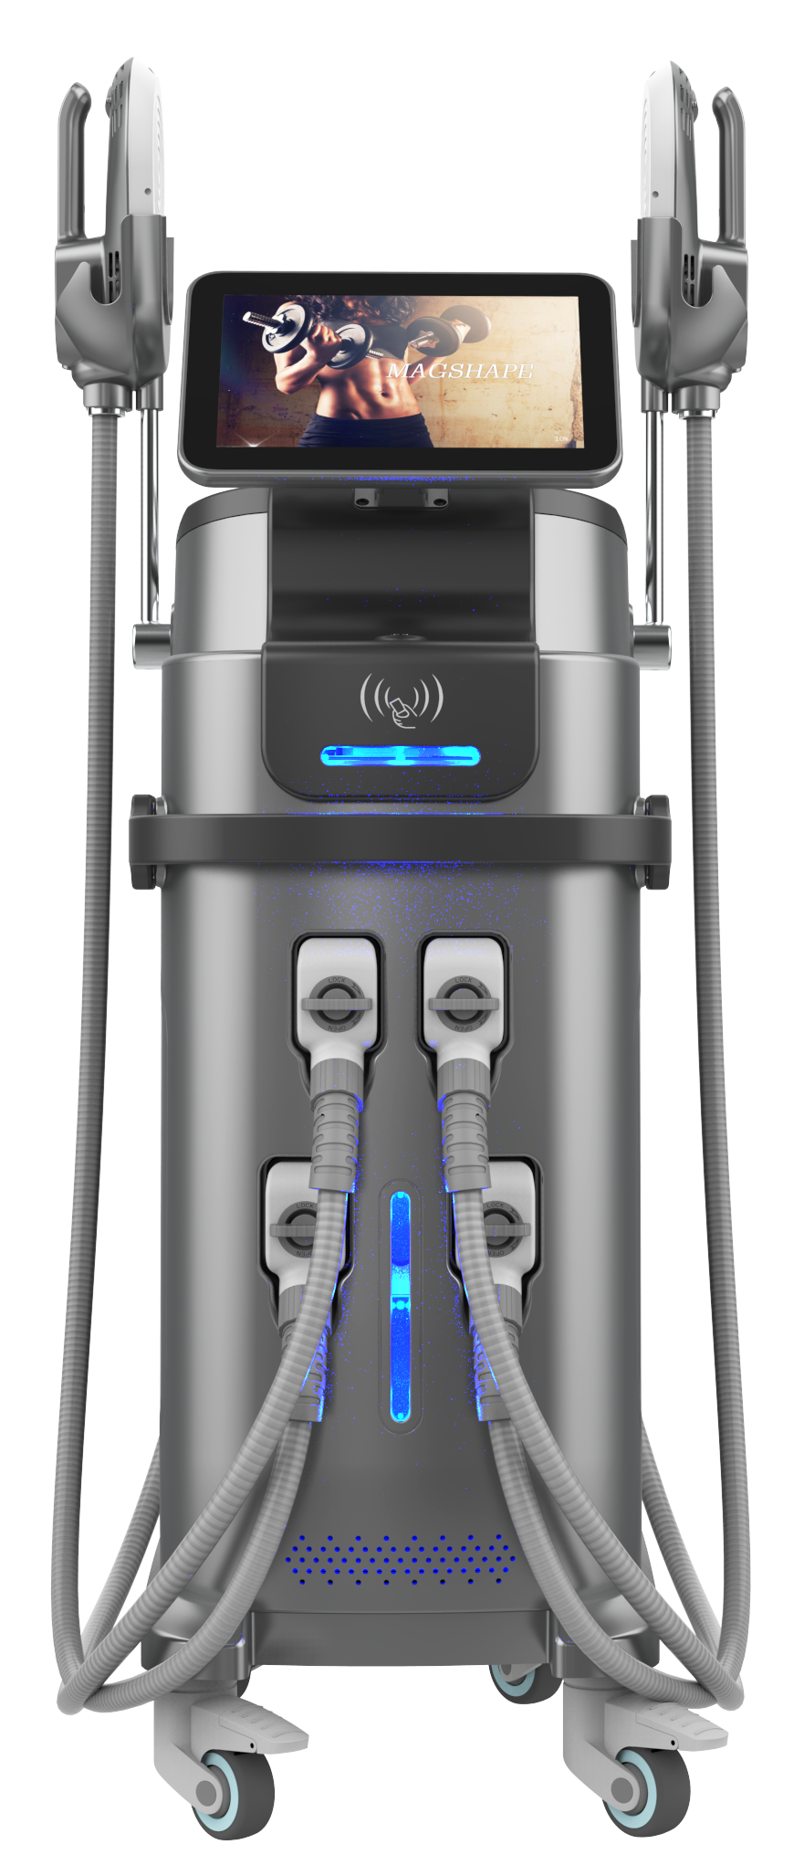
Specification
Magnetic wave（energy） | 0-7tesla
VOltage | 220V
Out put power | 4300W
Frequency | F1:1-10Hz F2:1-100Hz
pulse width | 300us
Mode | model-I （Sport mode） model-II （Gentle mode） model-Ⅲ（Professional mode）
screen | 10.4 inch
Treatment handle | 4 handles
machine size | 1500mm*360mm*520mm
package size | 1150mm*540mm*840mm
Net weight | 75kg
Gross weight | 105kg
Specification

Slide 8
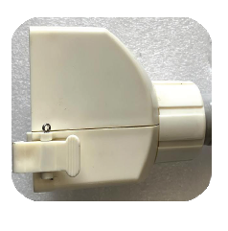
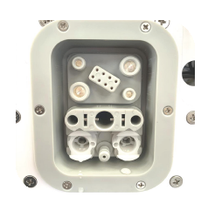
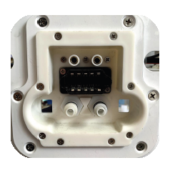
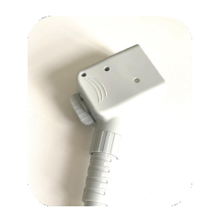

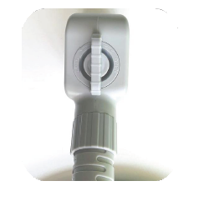

Old style
New style
Specification
Advantage
The old plug is difficult for women to install.
The new type adopts a screw rod to rotate and install,
easy installation and no bad contact.
MAGSHAPE
HI-EMT

Slide 9


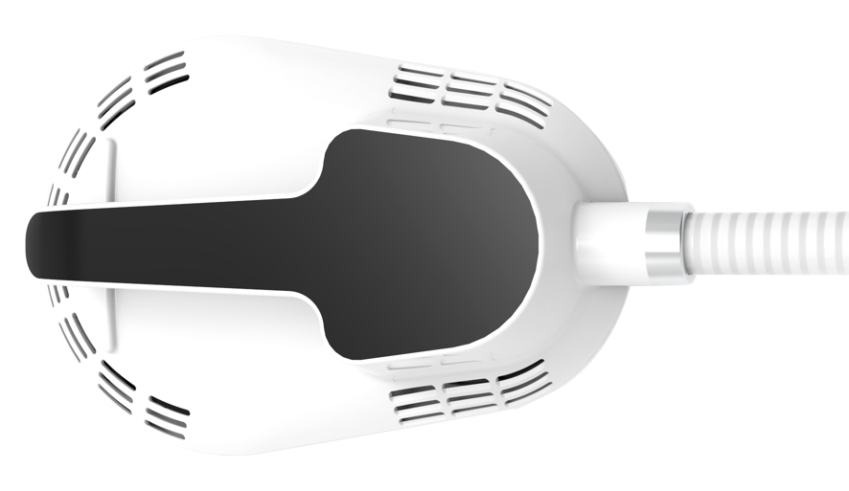

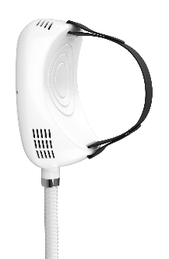

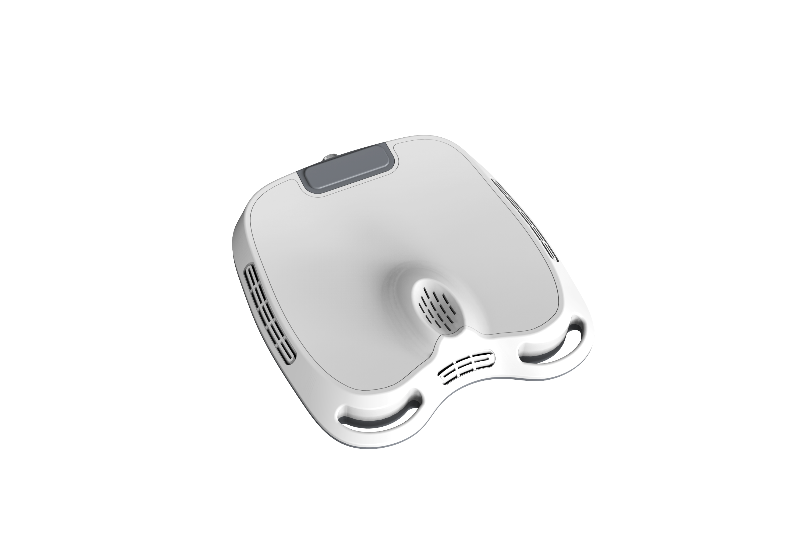

Belly Buttocks Thighs
USING FOR:
Thighs Arms Legs
USING FOR:
magshape munfunctional handles
MAGSHAPE
Urology
gynaecology
Postpartum repair
USING FOR:
HI-EMT

Slide 10
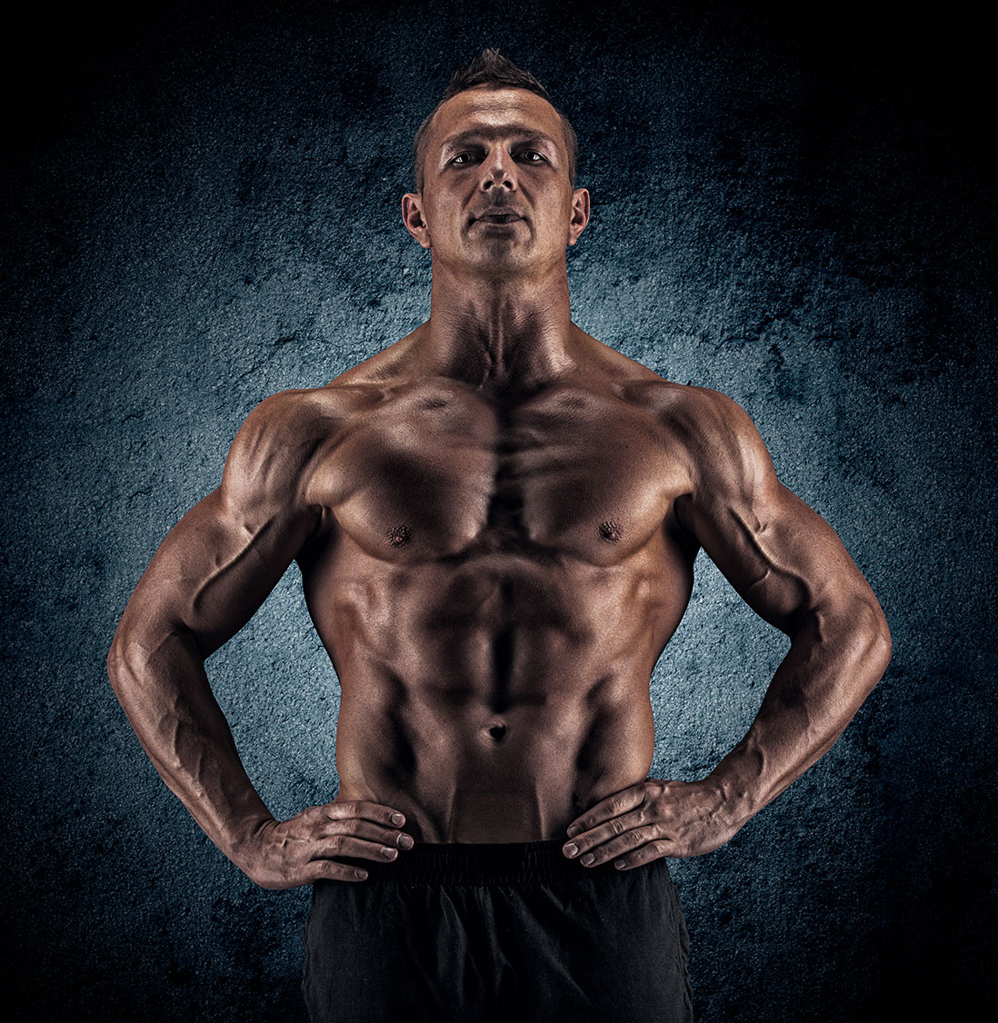
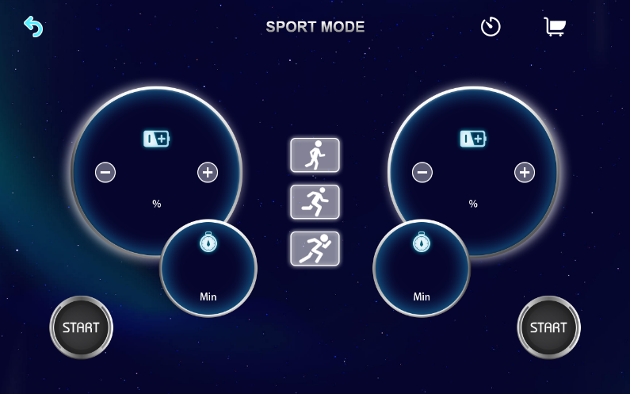
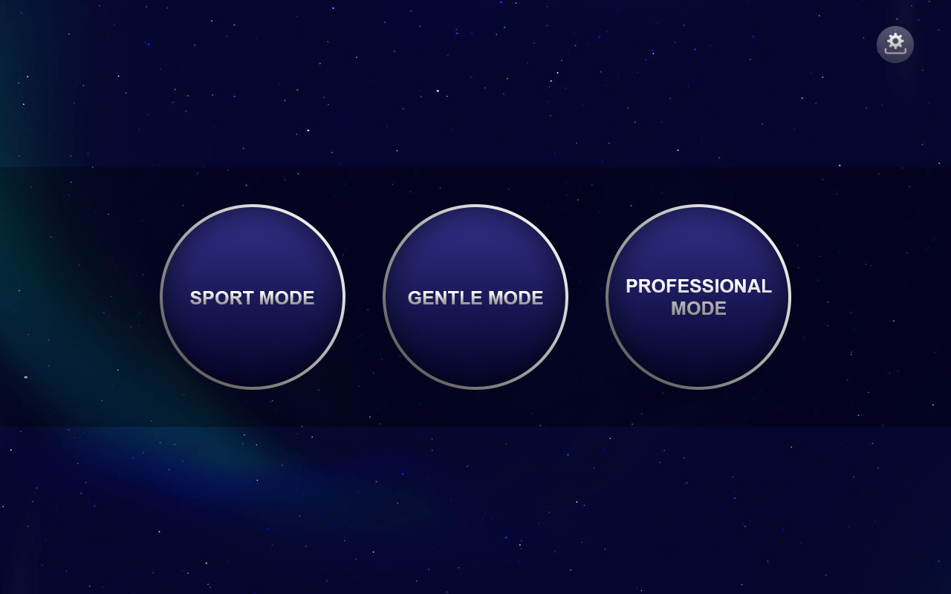
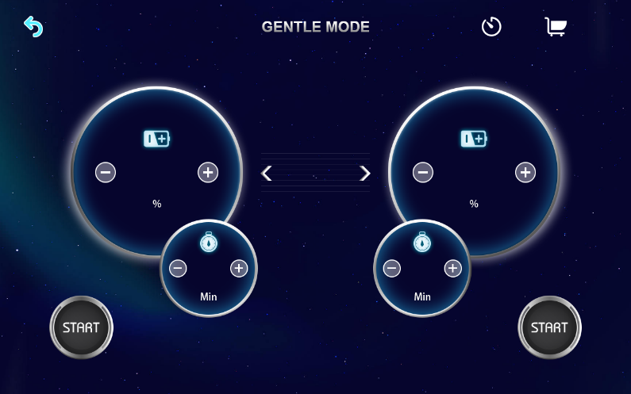
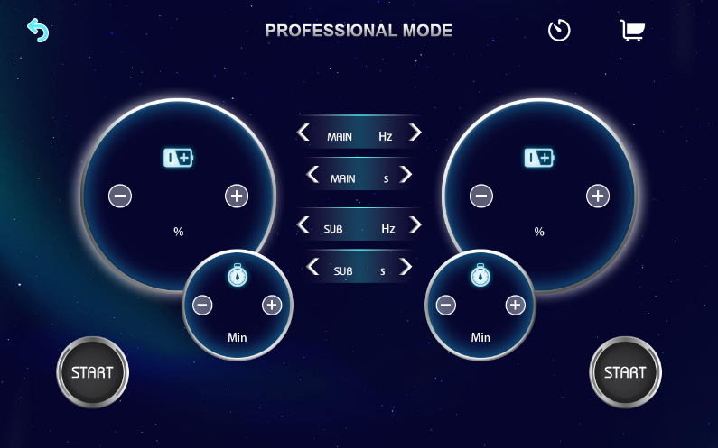
System Mode
3 WoRK Modes
Sport Mode
Gentle Mode
MAGSHAPE
Professional Mode
HI-EMT

Slide 11
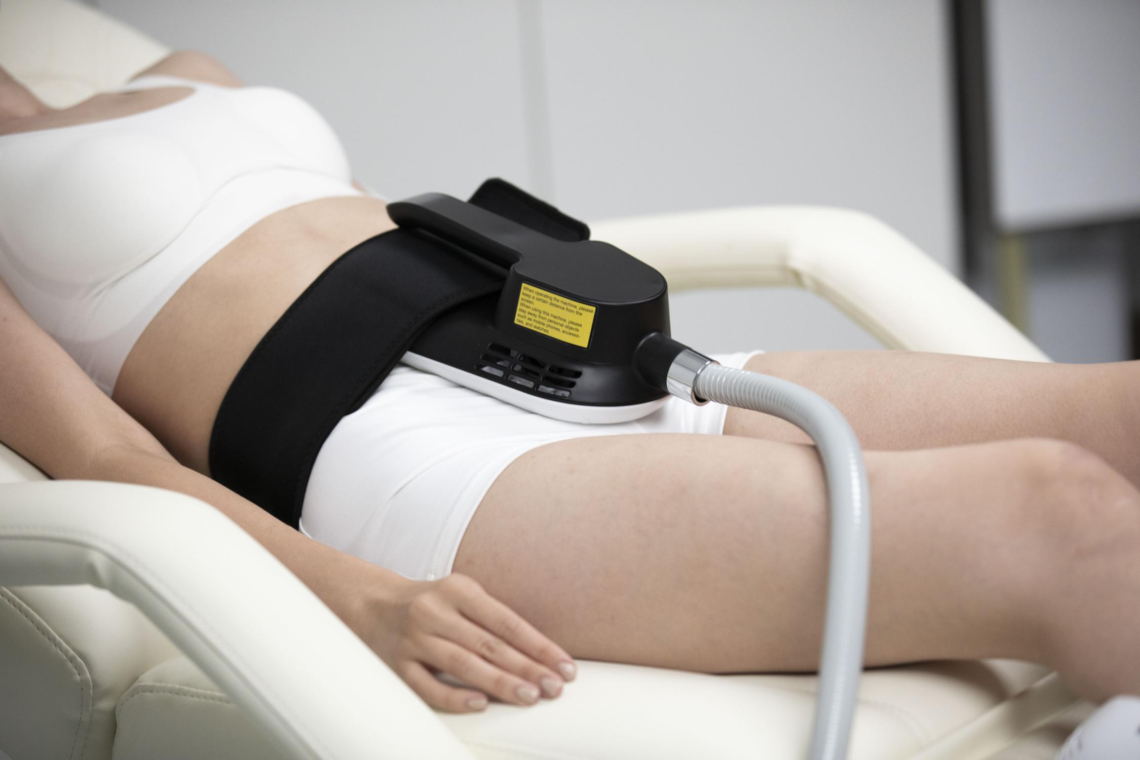
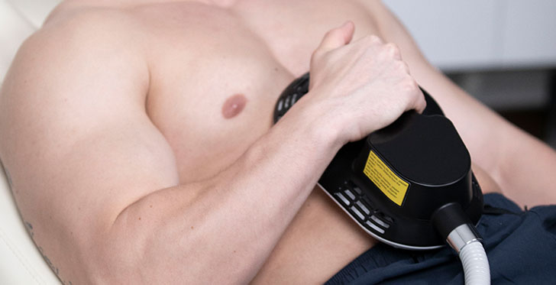
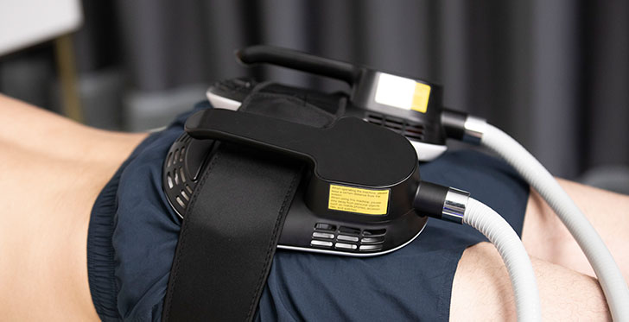
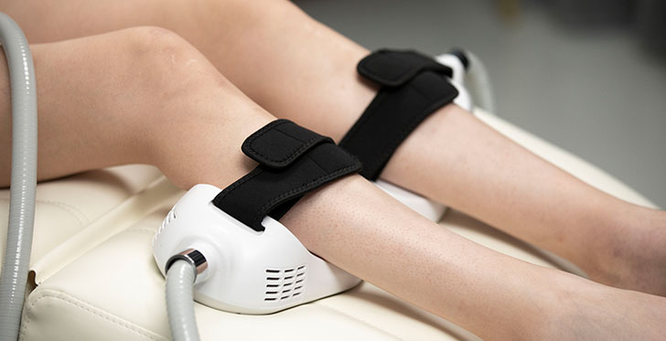
User experience

Slide 12
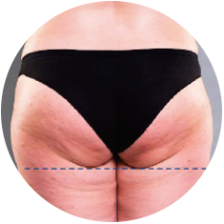
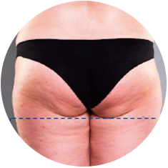
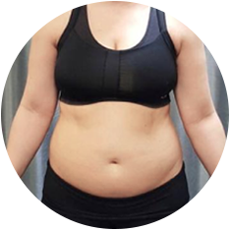
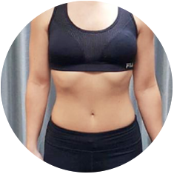
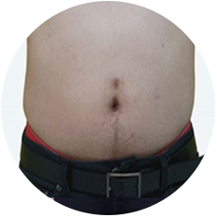
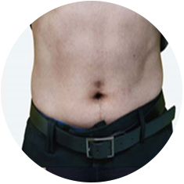
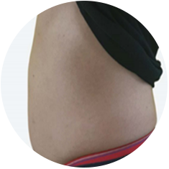
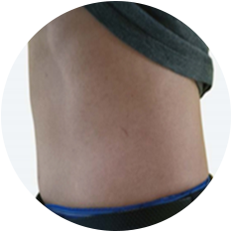
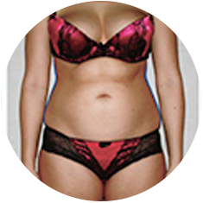
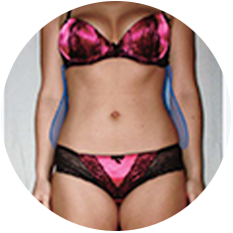
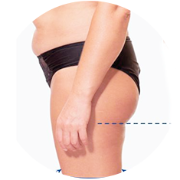
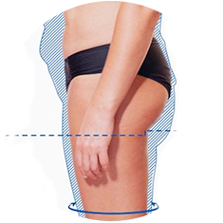
Before & After

Slide 13
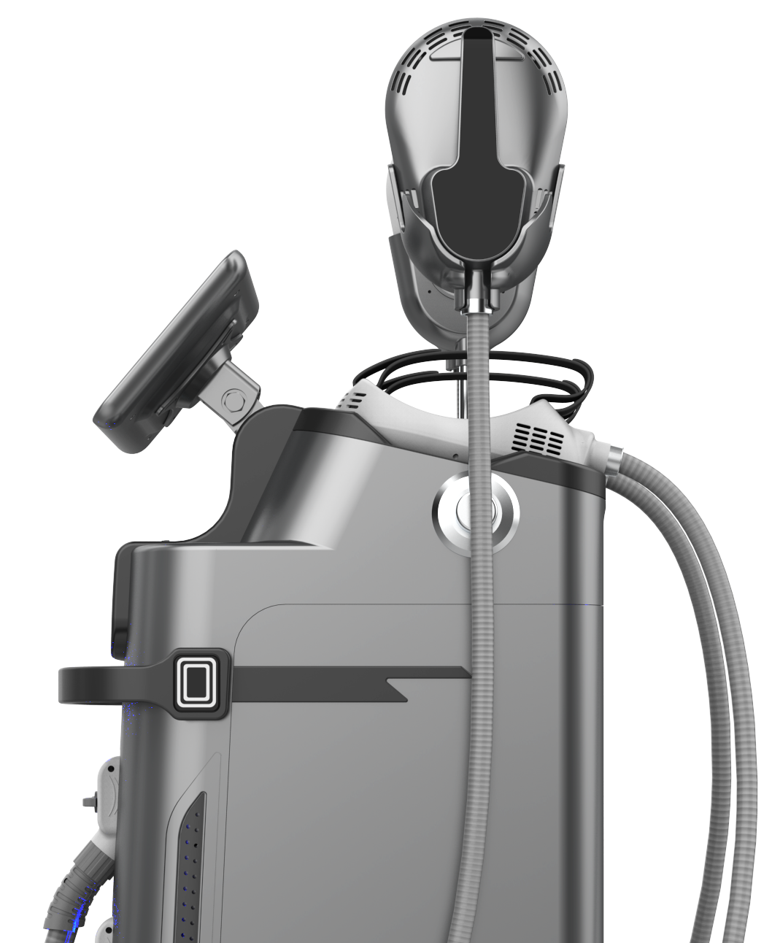

THANKS

